Slide 1





Bradford pear and callery pear: evolving pest plants
Dr. David Coyle
Clemson University
dcoyle@clemson.edu
@drdavecoyle

Slide 2



My partners-in-crime (aka coauthors)
J.T. Vogt
David Jenkins
Chip Bates
Chris Barnes
Chris Crowe
Scott Horn

Slide 3
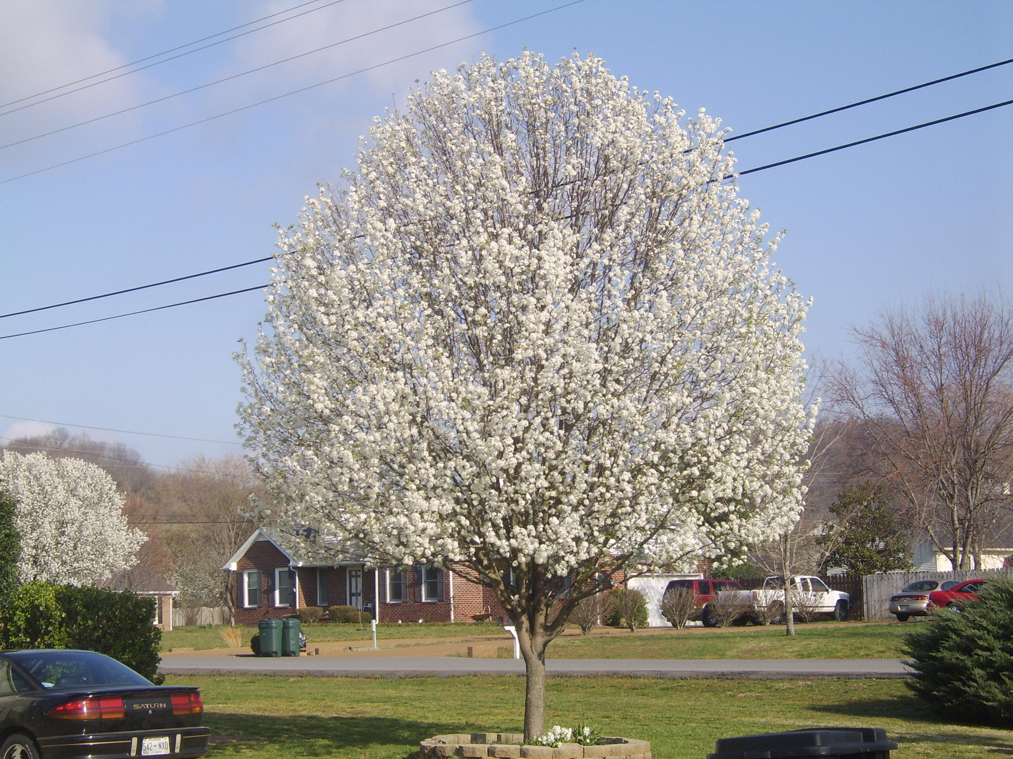
Callery pear
Smells like rotting fish and semen
-Business Insider, 2013
Pretty flowers
ddd
https://www.thelostogle.com/2018/03/19/bradford-pears-oklahoma-smell/

Slide 4
First, we must talk about fire blight

Slide 5
Fire blight
Erwinia amylovora
Devastating bacterial disease
Affects pear, apple, other Rosaceae

Slide 6
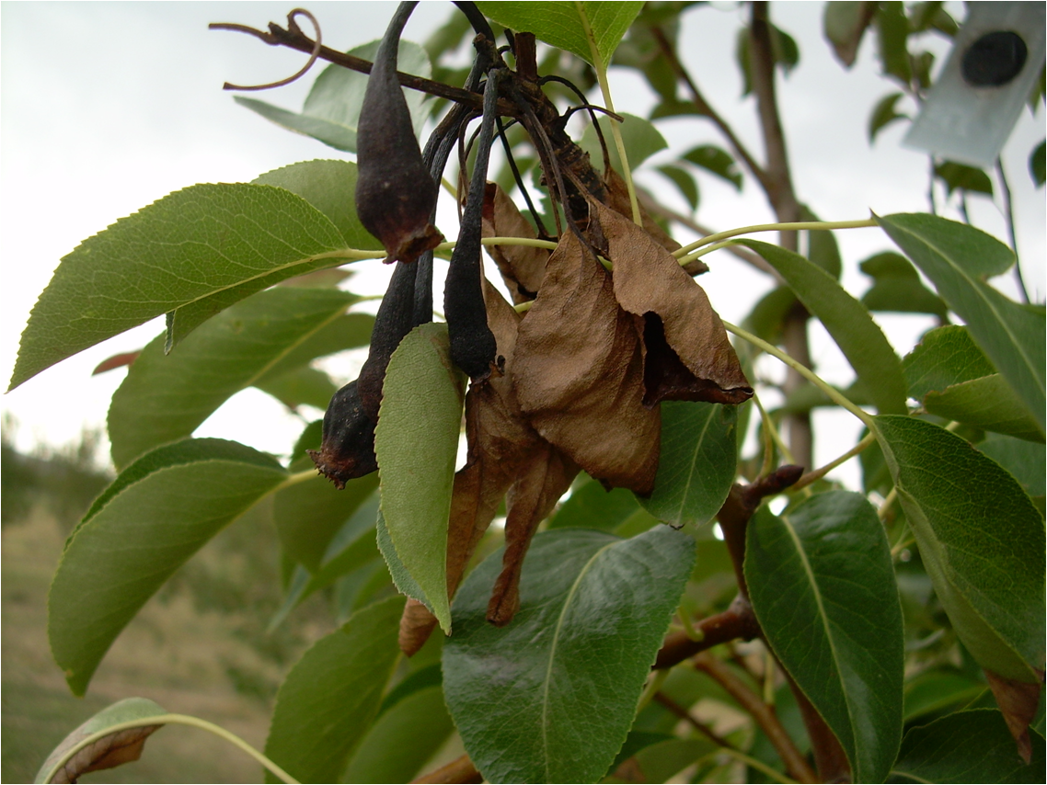
Bradford pear
Fire blight
Affects leaves and fruit
By Ninjatacoshell - Own work, CC BY-SA 3.0, https://commons.wikimedia.org/w/index.php?curid=6770373

Slide 7
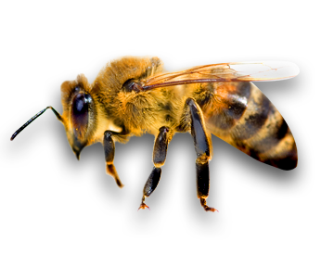
Fire blight
Devastating bacterial disease
Affects pear, apple, other Rosaceae
Rampant in U.S. in early 1900s
Spread by pollinators
The industry needed help

Slide 8
Pyrus calleryana (callery pear)
Native to Asia
Resistant to fire blight!
Introduced to U.S. to try to halt the disease
But…we needed more specimens for experiments…

Slide 9
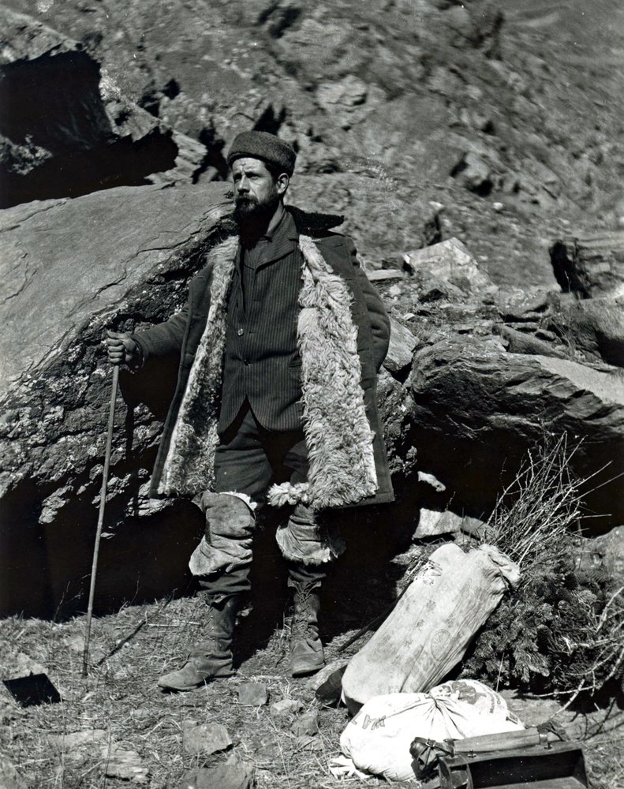
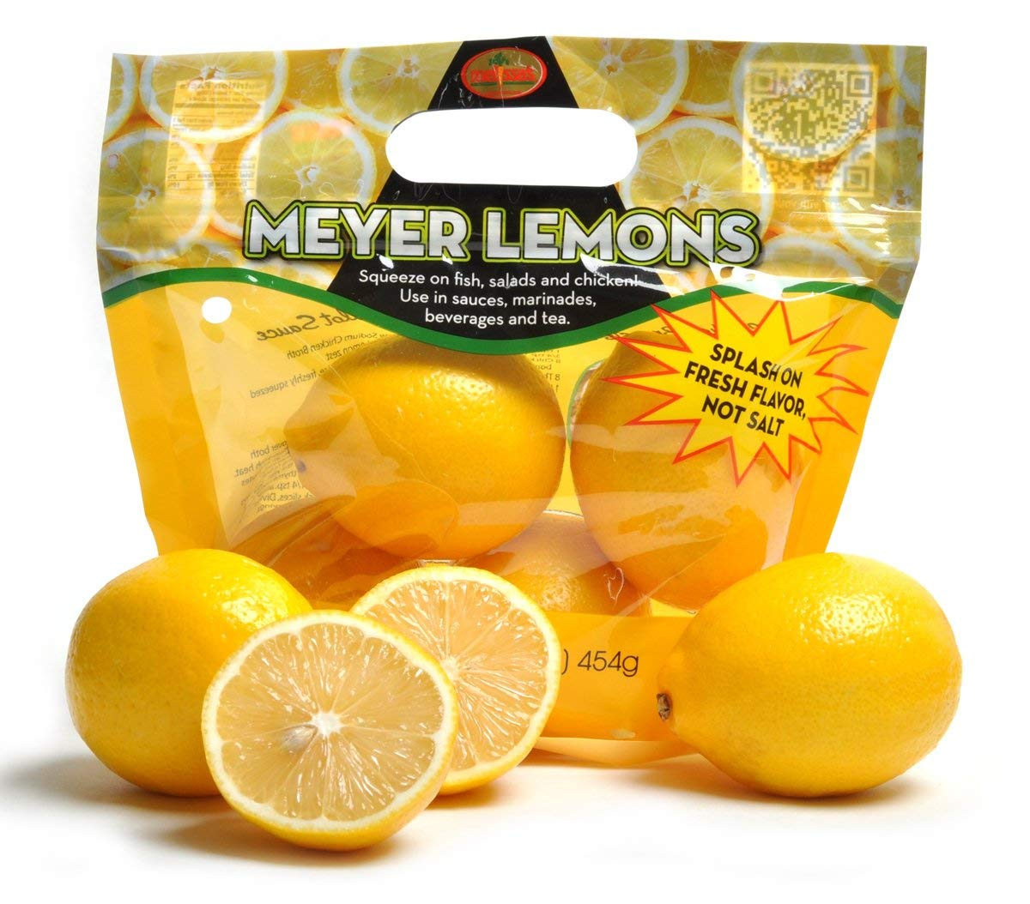

Frank N. Meyer
1875-1918
Worked for USDA
Many collecting trips
>2,500 plants to U.S.
Frank N. Meyer Medal for Plant Genetic Resources
https://www.nal.usda.gov/exhibits/speccoll/exhibits/show/frank-meyer

Slide 10
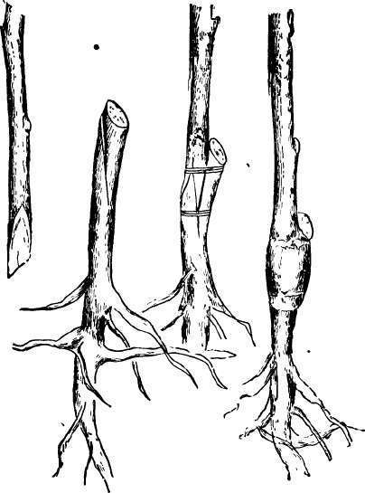
It worked!
P. calleryana helped SAVE the pear industry
Scion from a native, edible pear
Callery pear rootstock

Slide 11
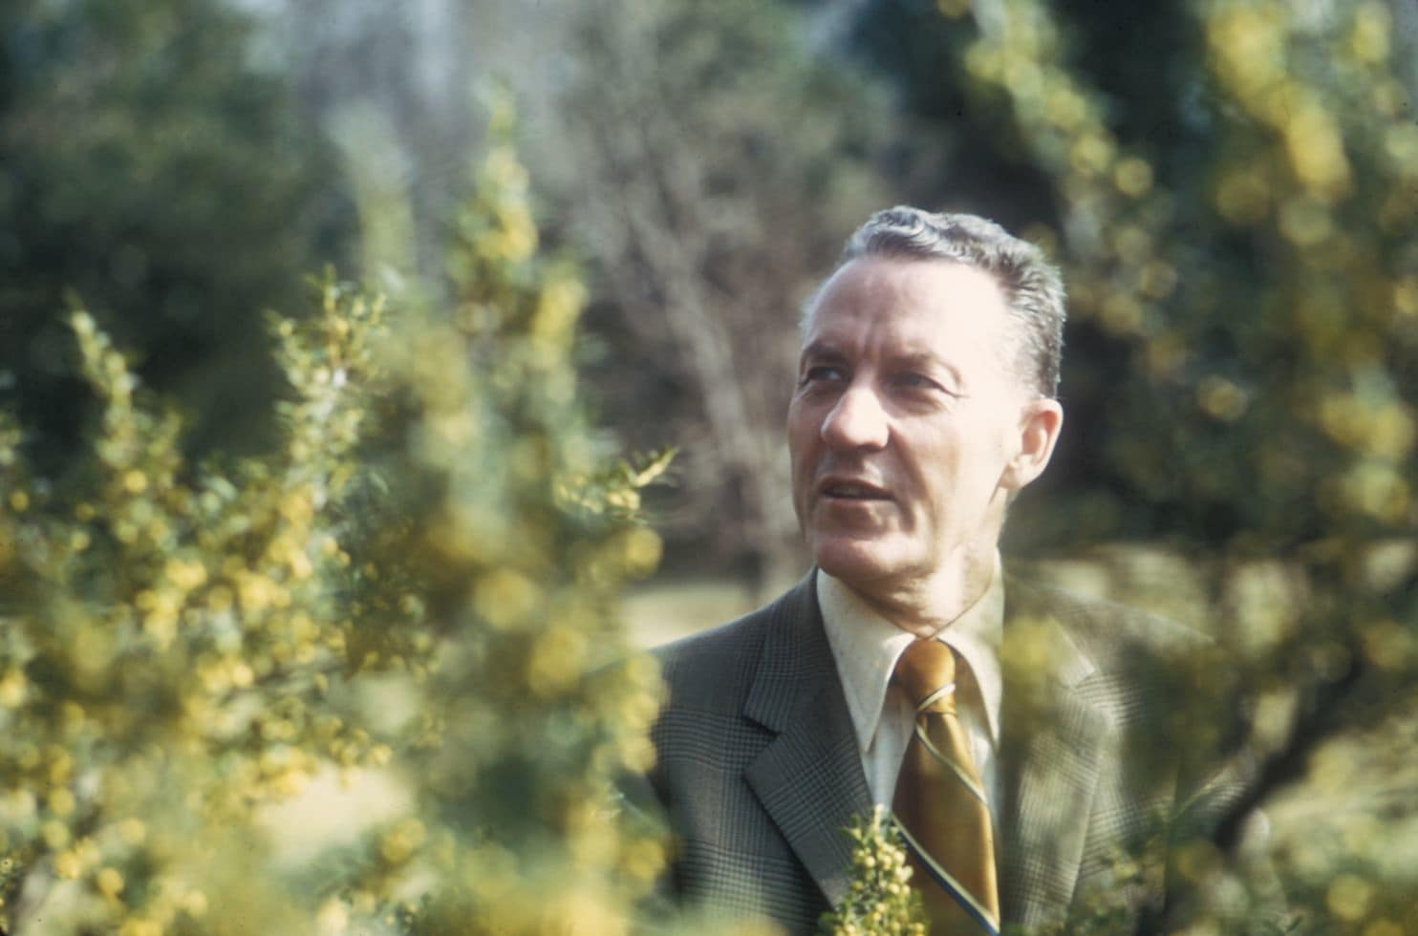
But…then…
Several outplantings located at the U.S. Plant Introduction Station in Glenn Dale, MD
Some P. calleryana selections had horticultural value
  Disease resistant
  Drought resistant
  Pollution resistant
John Creech, Horticulturalist
https://www.washingtonpost.com/lifestyle/magazine/how-we-turned-the-bradford-pear-into-a-monster/2018/09/14/f29c8f68-91b6-11e8-b769-e3fff17f0689_story.html?utm_term=.889f16322662

Slide 12
One selection was thornless!
Named it “Bradford” after former station director.
All scions were Bradford (thornless shoot)
Rootstocks were all P. calleryana, but of different genetics

Slide 13
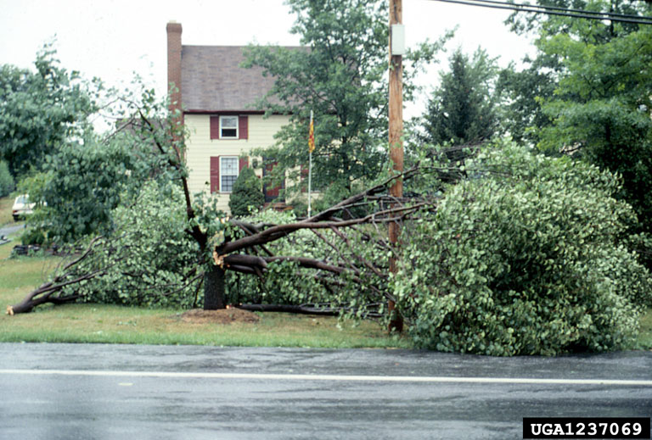
Bradford pear: what they knew
Branch structure issues around 25-30 years old

Slide 14

Bradford pear: what they knew
Only Bradford pear = no seeds
Bradford pear + other Pyrus = seeds
Their response?

Slide 15
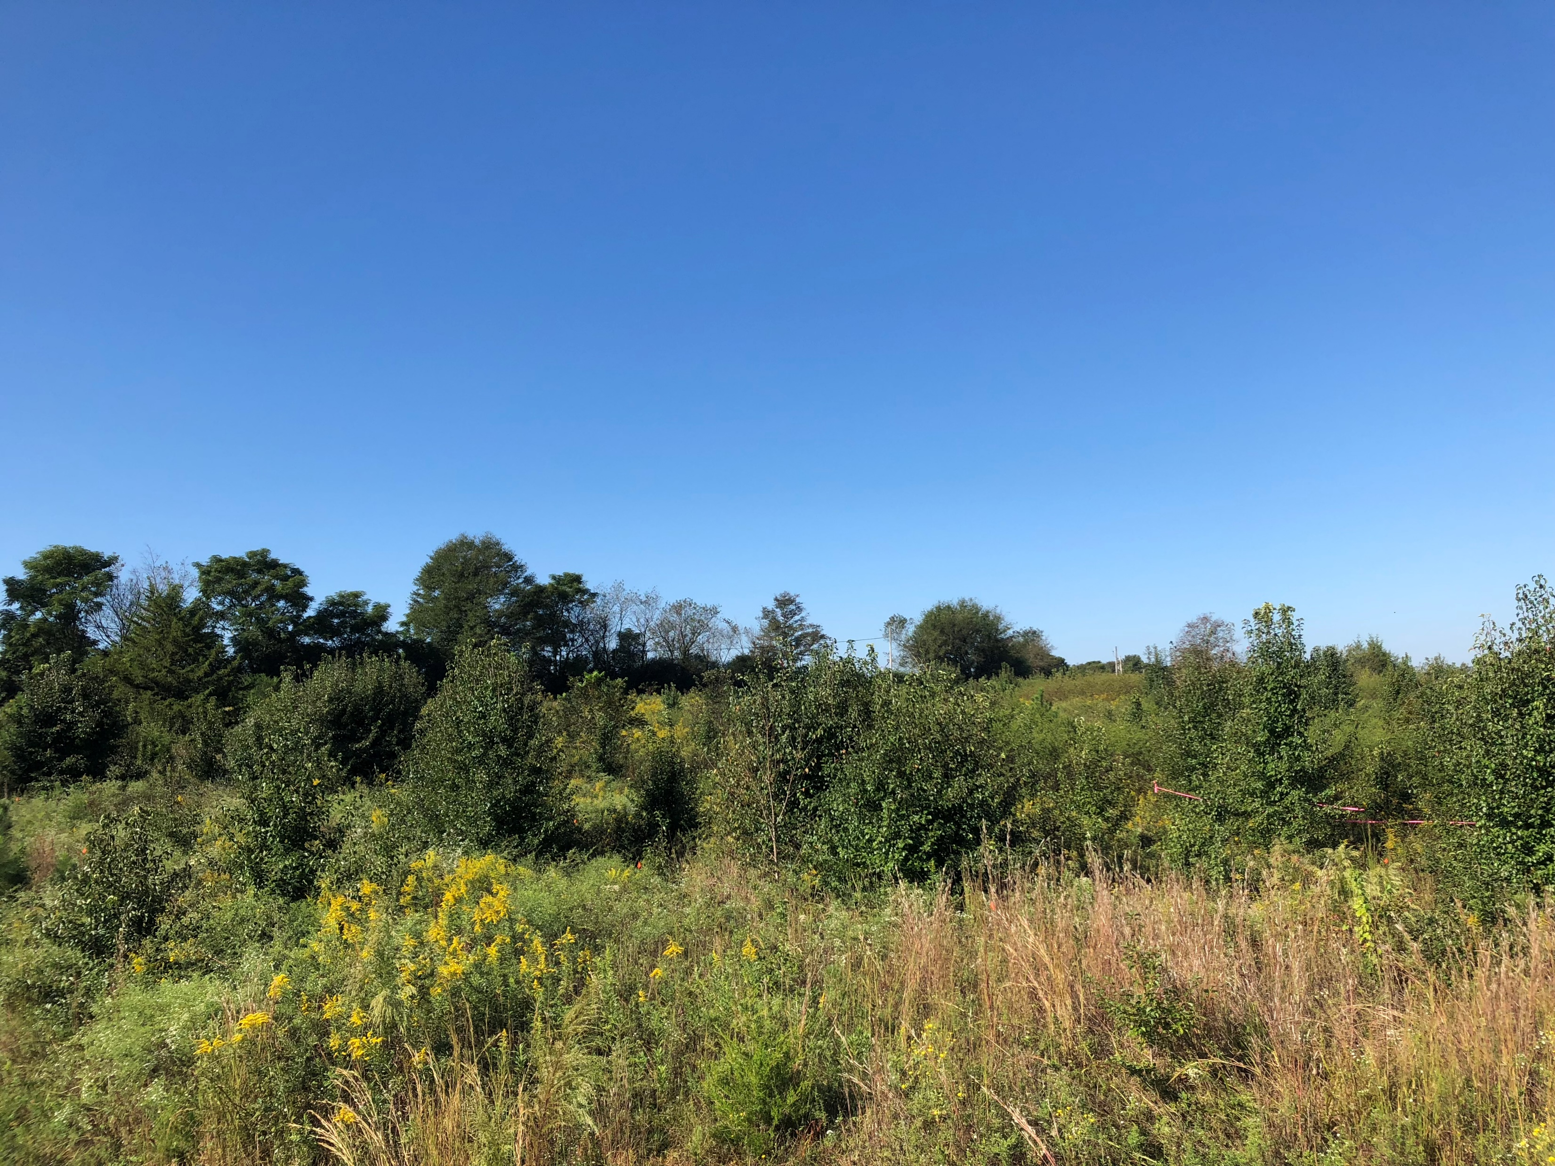
So now we have wild callery pear in old fields…

Slide 16
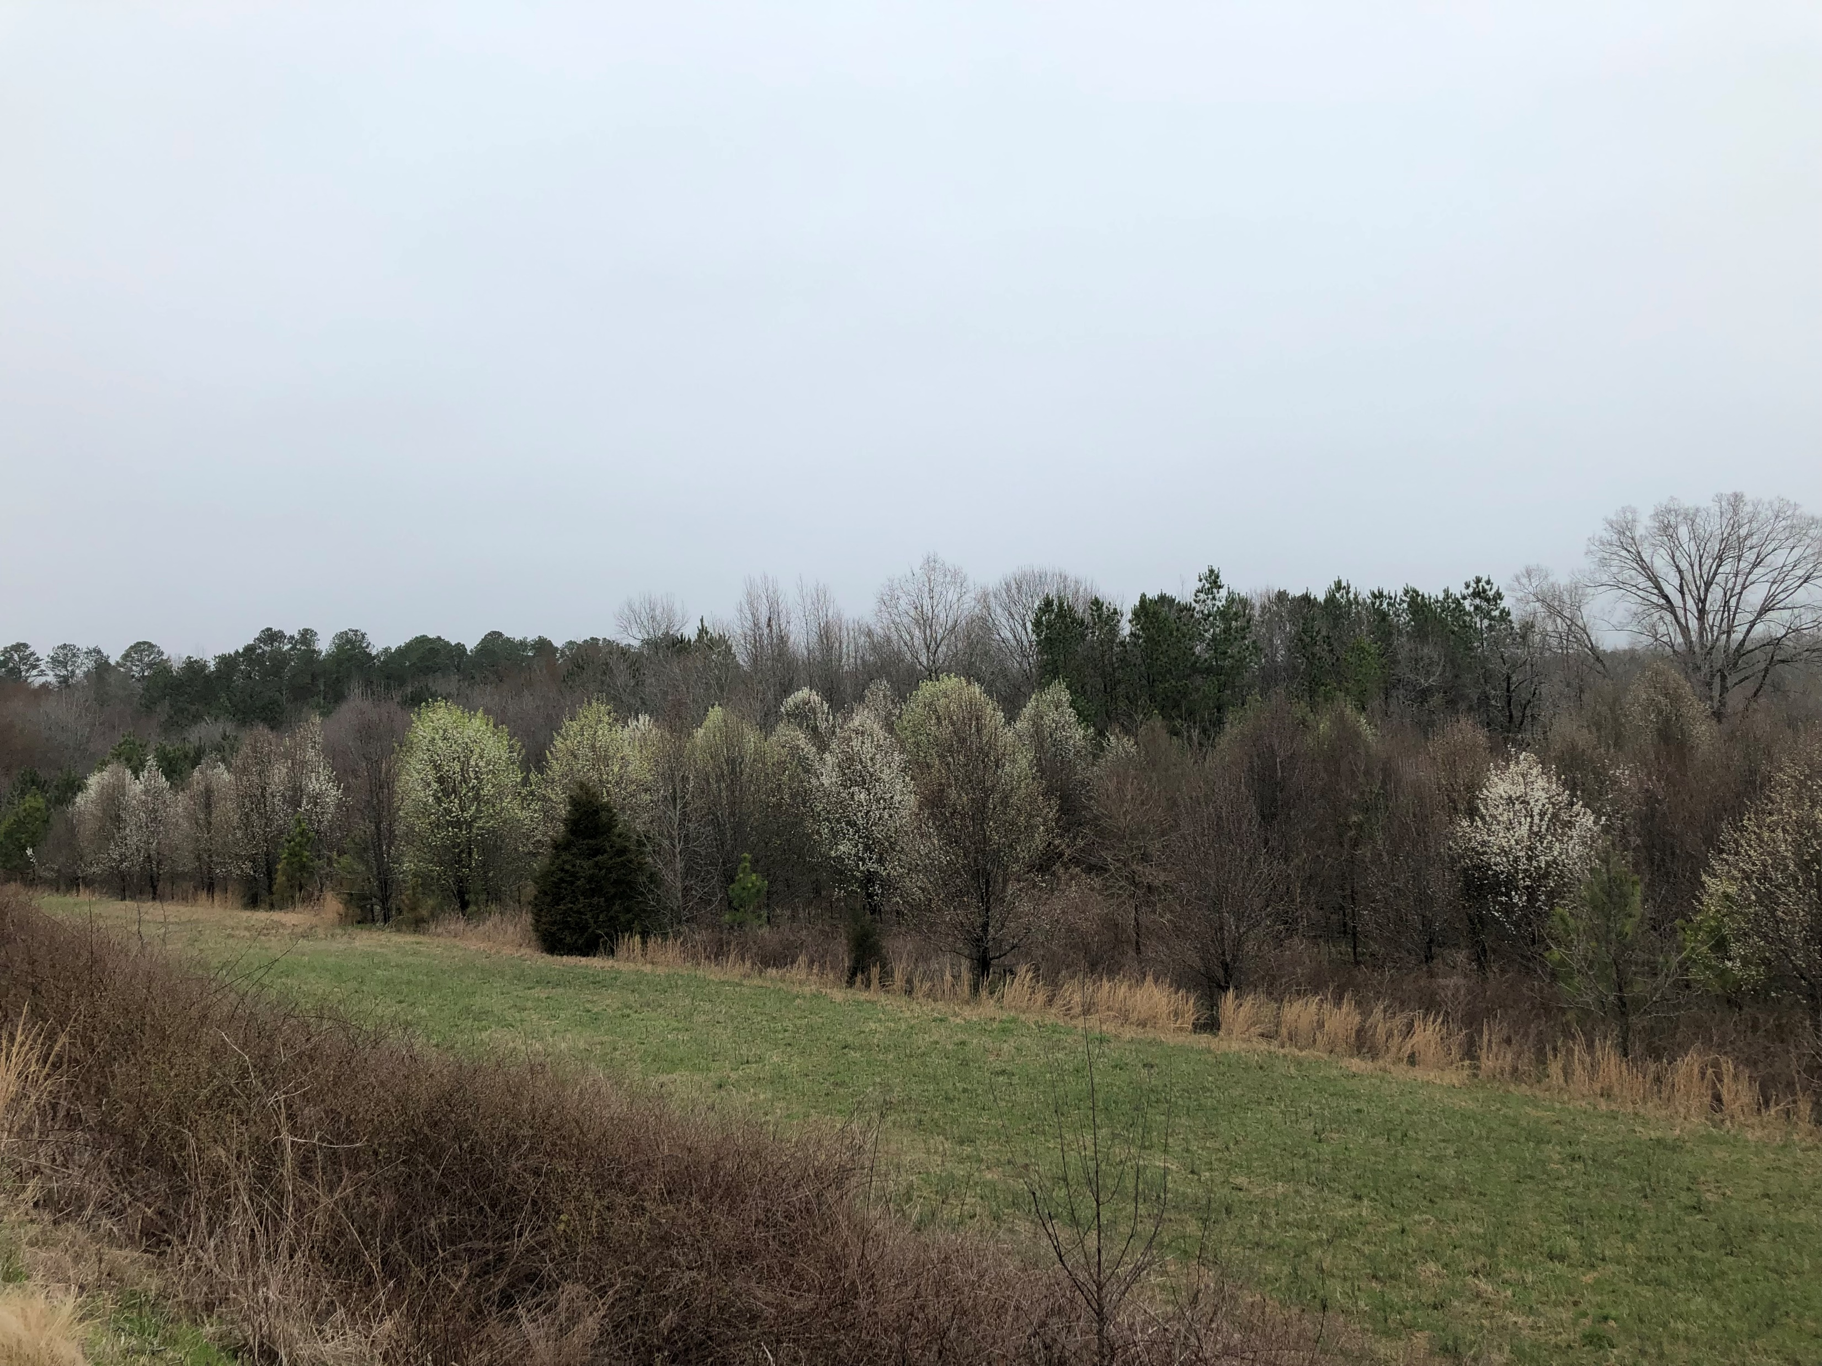
Along roadsides…

Slide 17
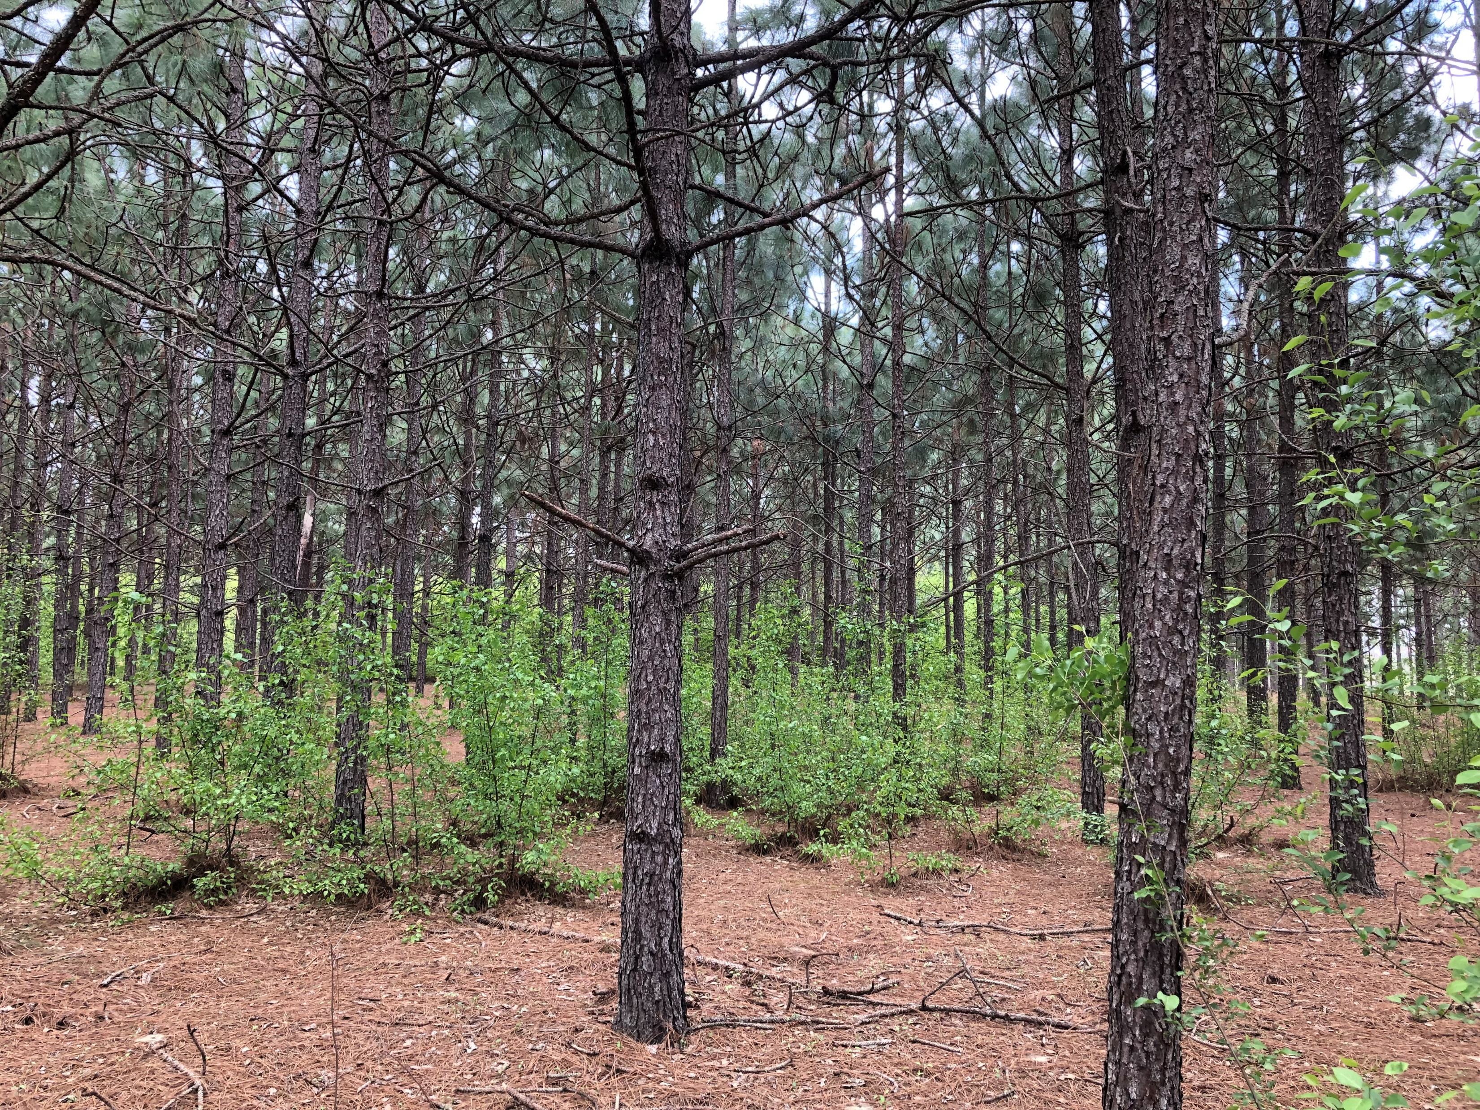
In forests…

Slide 18
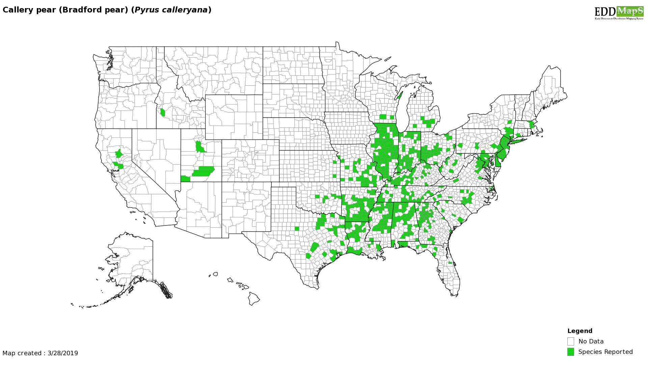
And let’s be honest, this map is REALLY incomplete.

Slide 19
What to do now?
Figure out how to manage (kill) it, obviously.

Slide 20

What to do?
Cut it down!
Herbicide is a MUST!
Whooooooooah we’re halfway there…

Slide 21
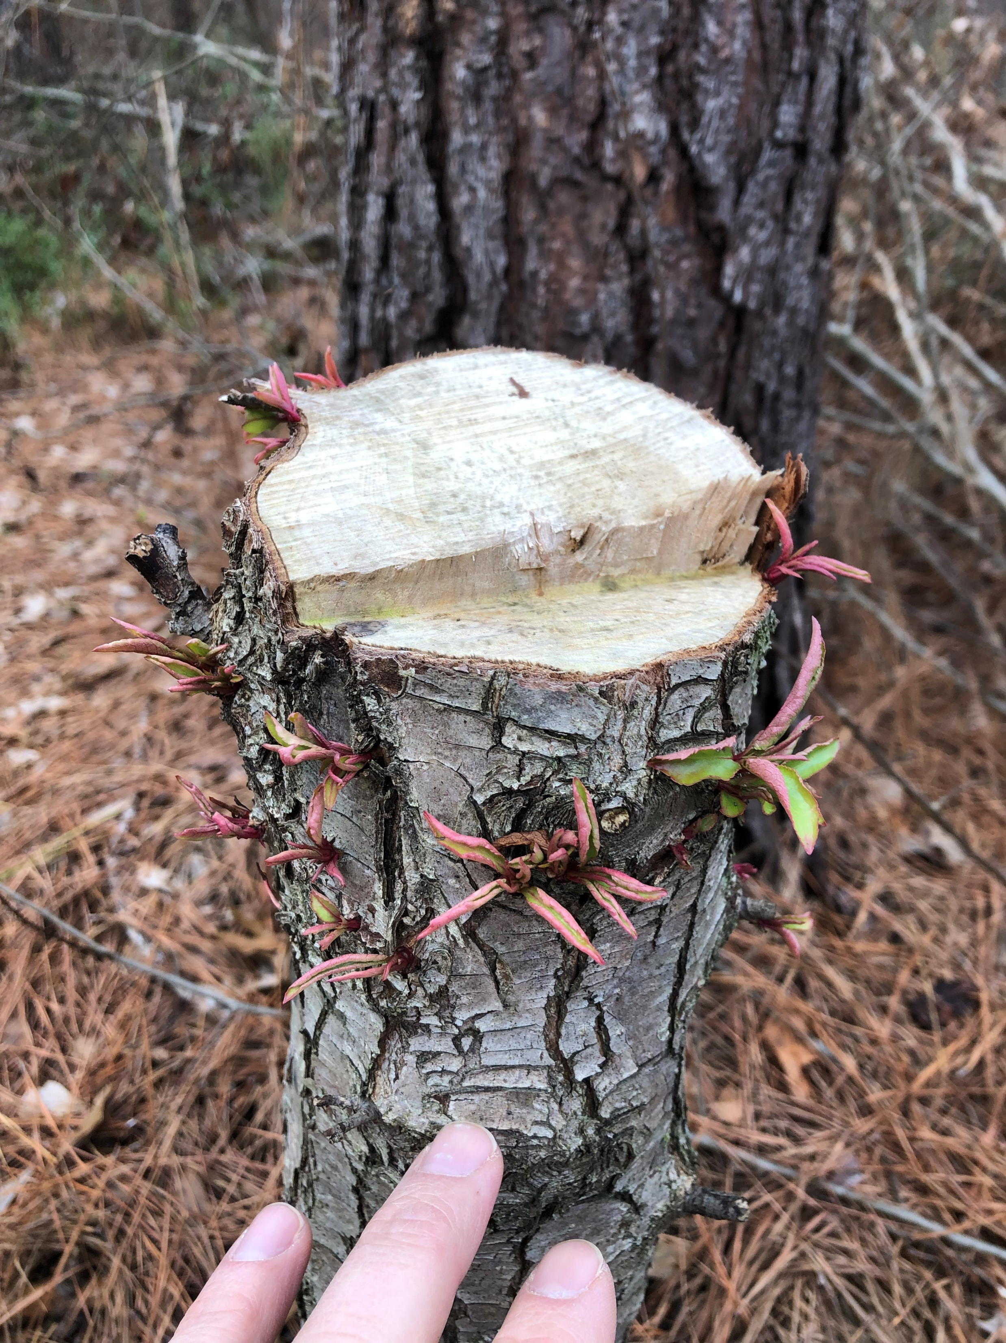
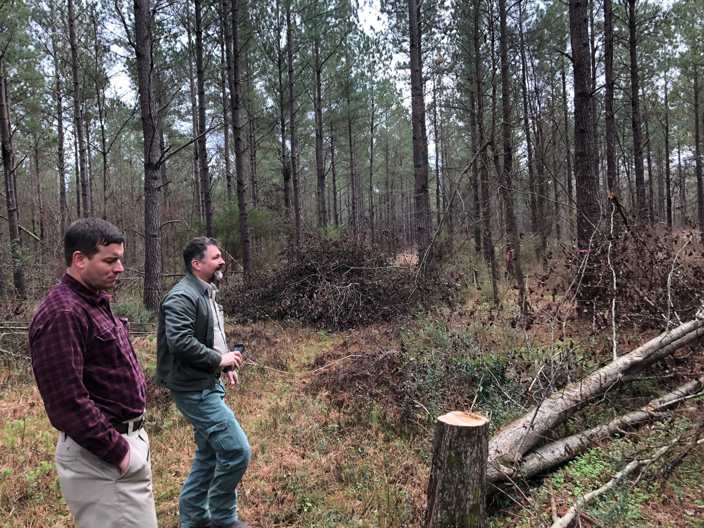
What to do?
Cut it down!
Spray it later?

Slide 22
What to do?
Biocontrol?
From Dr. Doug Tallamy, Univ. Delaware:
  White oak: 233 caterpillars, 15 species
  Black cherry: 53 caterpillars, 10 species
  Callery pear: 1 caterpillar, 1 species.
Basically nothing eats callery pear.

Slide 23
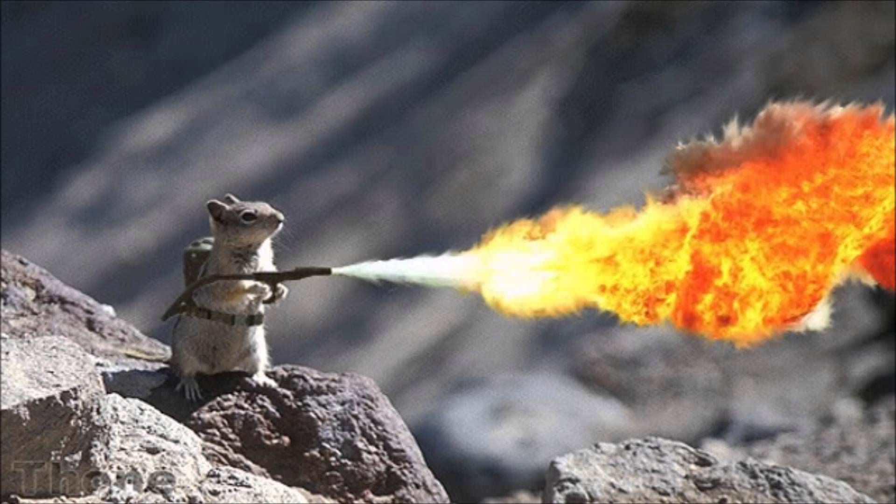
What to do?
Kill it with fire?

Slide 24
What to do?
Top kill, yes
  But you’ll just make it angry
Averaged 4 resprouts per stem post-fire
Warrix and Marshall 2018, Invasive Plant Science and Management 11: 27-32.

Slide 25
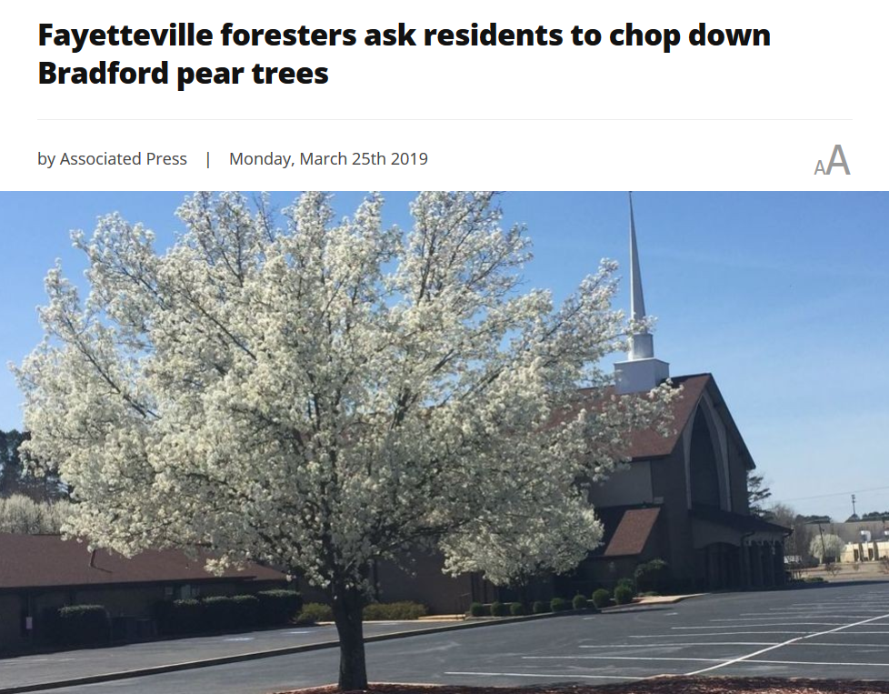
What to do?
Community engagement!

Slide 26
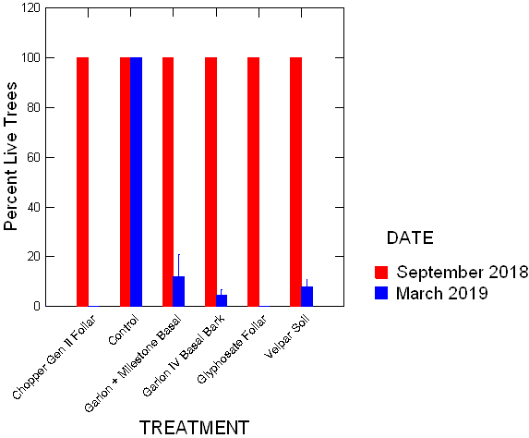
What to do?
triclopyr + aminopyralid
Herbicides
  They work!
glyphosate
imazapyr
tricopyr
hexazinone

Slide 27
Questions with control techniques
Lots of anecdotal information
  Few replicated studies
  Sharing is caring…
Optimal timing for each AI?
Impacts of tree size on AI efficacy?
Integrated pest management program?
  Fire + herbicides?
  Timing of each?

Slide 28
To recap:
Herbicides work
Techniques still need refining
Fire alone does not work
We know little about other control methods
What about combinations of fire + herbicide?

Slide 29
Shameless plug!
We need samples!
Google “callery pear population genetics”
http://southernforesthealth.net/plants/callery-pear/callery-pear-population-genetics-study
Thank you!

Slide 30



dcoyle@clemson.edu
drdavecoyle @drdavecoyle

