Slide 1
Just how controversial is the glyphosate controversy?
Stephen F. Enloe and Jason Ferrell
University of Florida - IFAS

Slide 2
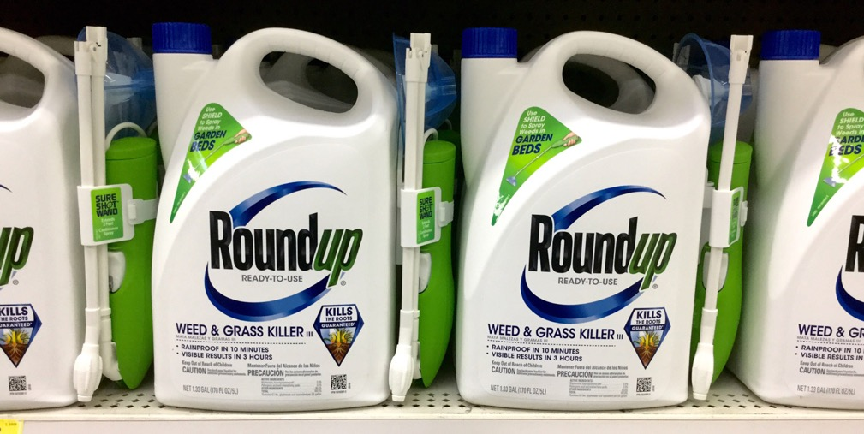
What is glyphosate?
Active ingredient in the world’s most commonly used herbicide

Slide 3
Why is glyphosate so common?
Its characteristics have made it VERY a useful tool
Non-selective
Non-volatile
No odor
Non-staining
No soil carryover
Highly effective
Inexpensive

Slide 4
Benbrook Environ Sci Eur (2016) 28:3
Question: Should we question and study the use of this much glyphosate?
Answer: ABSOLUTELY!

Slide 5
The Three Worlds of Science
Good Science
Semi-science
Solid
Non-biased
Credible peer review
Highly technical
“Scientific jargon” heavy
Often inaccessible to public
May ask good questions
May have some peer review
Extrapolates well beyond the data
More readily available online
More sensational
Fits data to preconceived ideas to drive a message
Bad Science (Fraud)
Fraud, scientific misconduct
Agenda driven
Sensational

Slide 6
If you look across the blogosphere…
Glyphosate is accused of…
Causing cancer
Being present at toxic levels in
Air
Rainwater
Urine
Breast milk
Wine
Honey
Vaccines
Tampons
These are the types of things that grab the public’s attention!

Slide 7
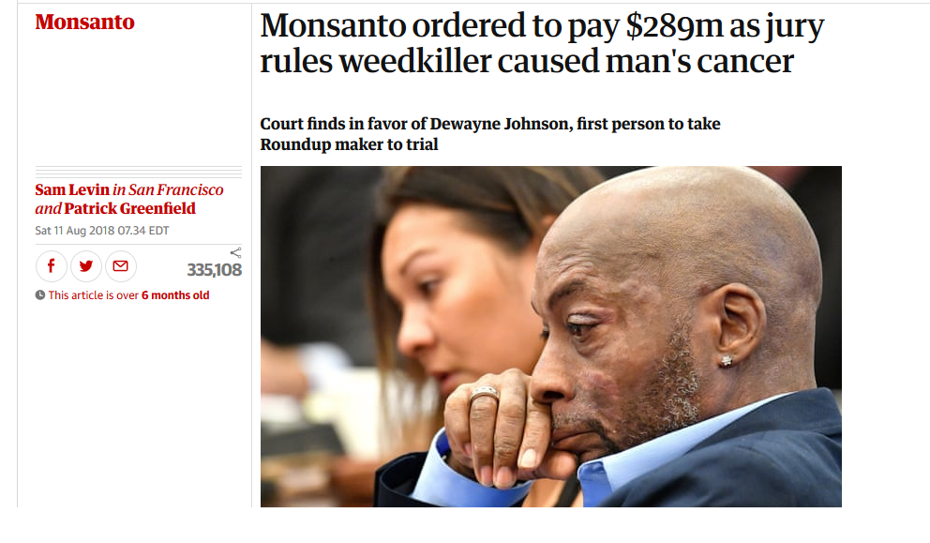

Slide 8
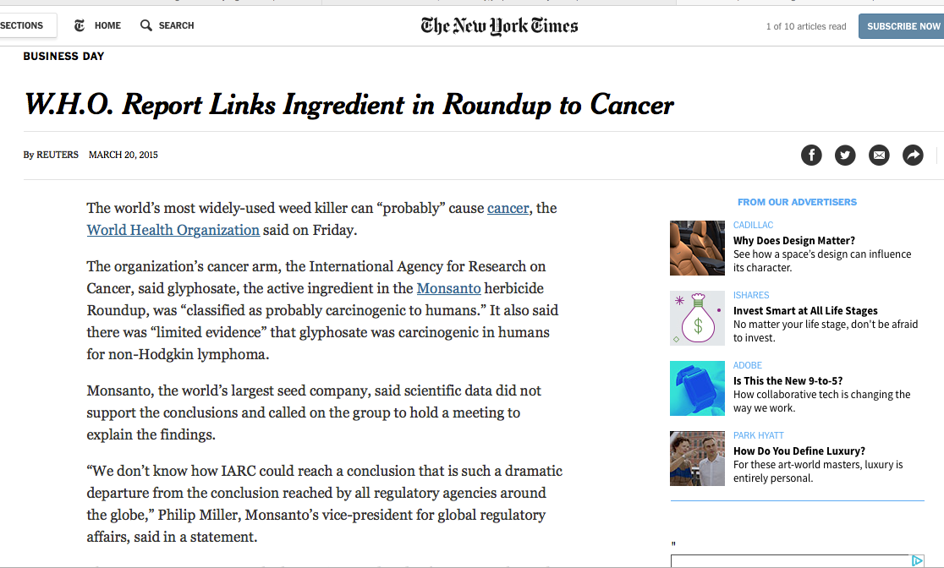

Slide 9
World Health Organization
March 2015, IARC reclassified glyphosate as “Probably Carcinogenic”
First...what is IARC?
Notes:
The WHO is a specialized agency of the United Nations that is concerned with international public health.

Slide 10
IARC: International Agency for Research on Cancer
IARC is a branch within WHO.
“Its role is to conduct and coordinate research into the causes of cancer. It also collects and publishes surveillance data regarding the occurrence of cancer worldwide.”
https://en.wikipedia.org/wiki/International_Agency_for_Research_on_Cancer

Slide 11
https://monographs.iarc.fr/agents-classified-by-the-iarc/

Slide 12
What is a probable carcinogen?
Probable doesn’t mean likely
“There is limited evidence of carcinogenicity in humans and sufficient evidence in experimental animals.”
http://monographs.iarc.fr/ENG/Preamble/CurrentPreamble.pdf

Slide 13
The EPA disagrees with IARC

Slide 14
EU disagrees with IARC
https://efsa.onlinelibrary.wiley.com/doi/epdf/10.2903/j.efsa.2015.4302

Slide 16
Canada disagrees with IARC
https://www.canada.ca/en/health-canada/news/2019/01/statement-from-health-canada-on-glyphosate.html

Slide 17
Why is there such disagreement with IARC?

Slide 18
Why are IARC and EPA at odds?
IARC assesses “hazard”
Is harm possible?
EPA assesses “risk”
Is harm likely?

Slide 19
Because they assess “hazard”, IARC has a high hit rate
“Over four decades, a WHO research agency has assessed 989 substances and activities, ranging from arsenic to hairdressing, and found only one was “probably not” likely to cause cancer in humans. It was an ingredient in nylon used in stretchy yoga pants and toothbrush bristles.”
https://www.reuters.com/investigates/special-report/health-who-iarc/

Slide 20
Why is there such disagreement with IARC?
It has to do with what data was included in the discussion.
IARC included two papers that EU, EPA, and Health Canada felt were insufficient.

Slide 21
Arch Toxicol (2017) 91:2723–2743

Slide 22
Even if everyone agreed, what are some other Probable Carcinogens?

Slide 23
Known vs. Probable Carcinogens
Known
Alcoholic beverages
Asbestos
Tobacco
Plutonium
Solar Radiation
UV Tanning Beds
http://www.cancer.org/cancer/cancercauses/othercarcinogens/generalinformationaboutcarcinogens/known-and-probable-human-carcinogens

Slide 24
Known vs. Probable Carcinogens
Known
Alcoholic beverages
Asbestos
Tobacco
Plutonium
Solar Radiation
UV Tanning Beds
Probable
Glyphosate
Hair products (work exposure)
Red Meat (consumption)
Beverages >150 F (consump.)
McDonald’s coffee (180-190F)
Shiftwork (circadian disruption)
http://www.cancer.org/cancer/cancercauses/othercarcinogens/generalinformationaboutcarcinogens/known-and-probable-human-carcinogens

Slide 25
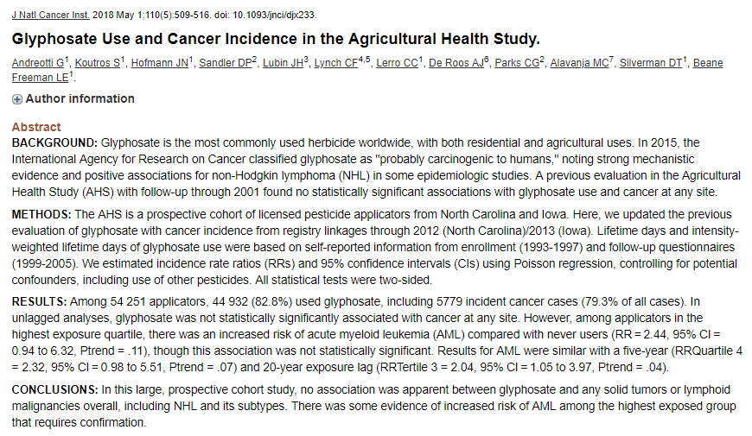
What was not included: unpublished AHS study data

Slide 26
California Office of Environment Health Hazard Assessment July 2017, proposes warning label under Prop 65

Slide 27
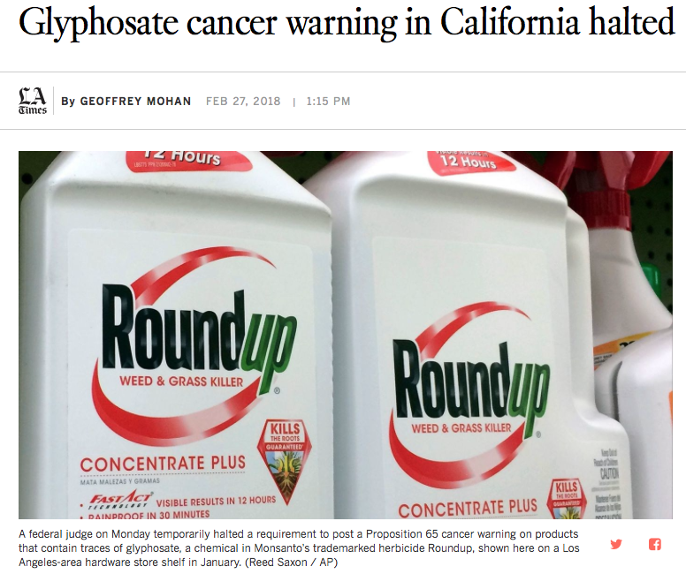
California Court blocks warning label
http://www.latimes.com/business/la-fi-glyphosate-prop65-story.html

Slide 28
Judge William Shubb - ruling
Shubb said a cancer warning would be "misleading at best," given that "a reasonable consumer would not understand that a substance is 'known to cause cancer' where only one health organization had found that the substance in question causes cancer and virtually all other government agencies and health organizations that have reviewed studies on the chemical had found there was no evidence that it caused cancer."
http://www.latimes.com/business/la-fi-glyphosate-prop65-story.html

Slide 29
Why was Monsanto sued for millions?
https://www.theguardian.com/business/2018/aug/10/monsanto-trial-cancer-dewayne-johnson-ruling

Slide 30
“Monsanto Papers”
According to court documents:
There was evidence of Monsanto employees “ghost writing” articles to minimize the cancer concerns

Slide 31
EU and other agencies have thoroughly reviewed these documents
http://www.efsa.europa.eu/sites/default/files/topic/20170608_glyphosate_statement.pdf

Slide 32
Ghost Writing Concerns
“Following this investigation, EFSA can confirm that even if the allegations regarding ghostwriting proved to be true, there would be no impact on the overall assessment as presented in the EFSA Conclusion on glyphosate.
...[If] these two review papers might have been ghostwritten by Monsanto, their provenance was evident from the Declarations of Interest and Acknowledgements in the papers themselves.
The review papers in question represented only two of approximately 700 scientific references in the area of mammalian toxicology considered by EFSA in the glyphosate assessment.”
http://www.efsa.europa.eu/sites/default/files/topic/20170608_glyphosate_statement.pdf

Slide 33
Some things to look out for…
Catchy headlines
Shock value
Absolutes (this study definitively proves…)
Sales pitches
Fear-mongering
Character assassination

Slide 35
Some things to look for…
Addressing study results in relation to the body of scientific literature on the issue
Cautious interpretation of results
Admission of study limitations
Follow-up peer review

Slide 36
University of Florida position
“UF/IFAS is committed to safety and supports integrated pest management as the first line of defense against weeds and other pests, including the use of glyphosate and other pesticides.”
Integrated Pest Management means using all reasonable options in concert to control pests
https://pested.ifas.ufl.edu/wp-content/uploads/2018/09/ICS_GlyphosateFactSheet03-9-17-18.pdf

Slide 37
Options if you choose not to use glyphosate in FL
Glyphosate - $15-26/gal;
No odor, no soil activity, controls grasses and forbes, upland or aquatic sites, no irrigation restrictions.
Imazapyr - $18/gal
No odor, controls grasses and forbs, significant soil activity. Upland and aquatic sites.
Can’t be used near desirable trees, 120d irrigation restriction
Tigr – $320/gal
Distinct odor, grasses only, no soil activity
Upland or aquatic, 30d irrigation restriction

Slide 38
Options if you choose not to use glyphosate
Triclopyr – $30-40/gal
4 different formulations: some for aquatic, some upland
Forbes only no grass; some formulations smell, some are volatile. Irrigation restriction – 120d

Slide 39
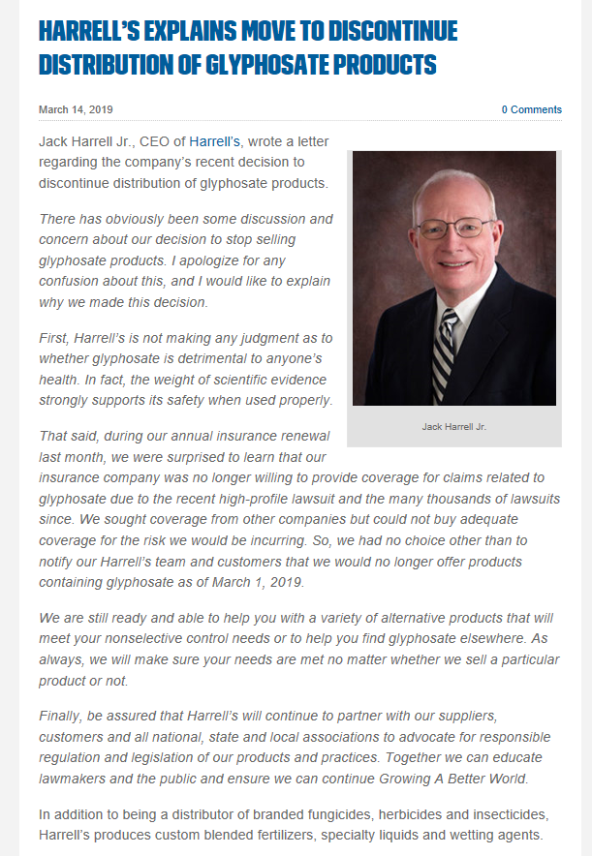
A new twist…
Insurance may become
a bigger issue than
the current lawsuits

Slide 40
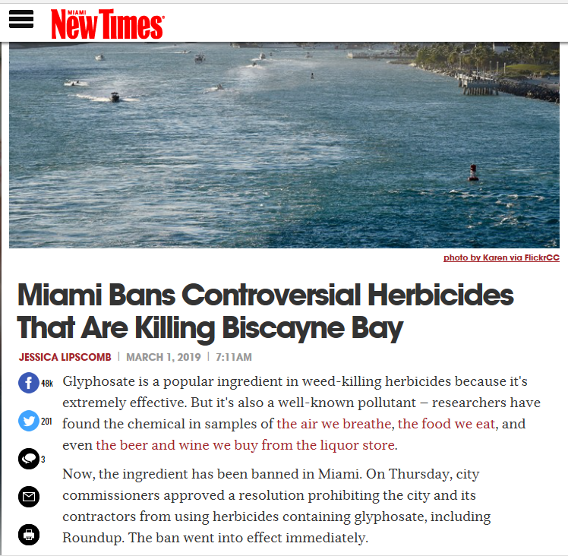

Slide 41
Questions?
Contact us:
sfenloe@ufl.edu
jferrell@ufl.edu

