Slide 1
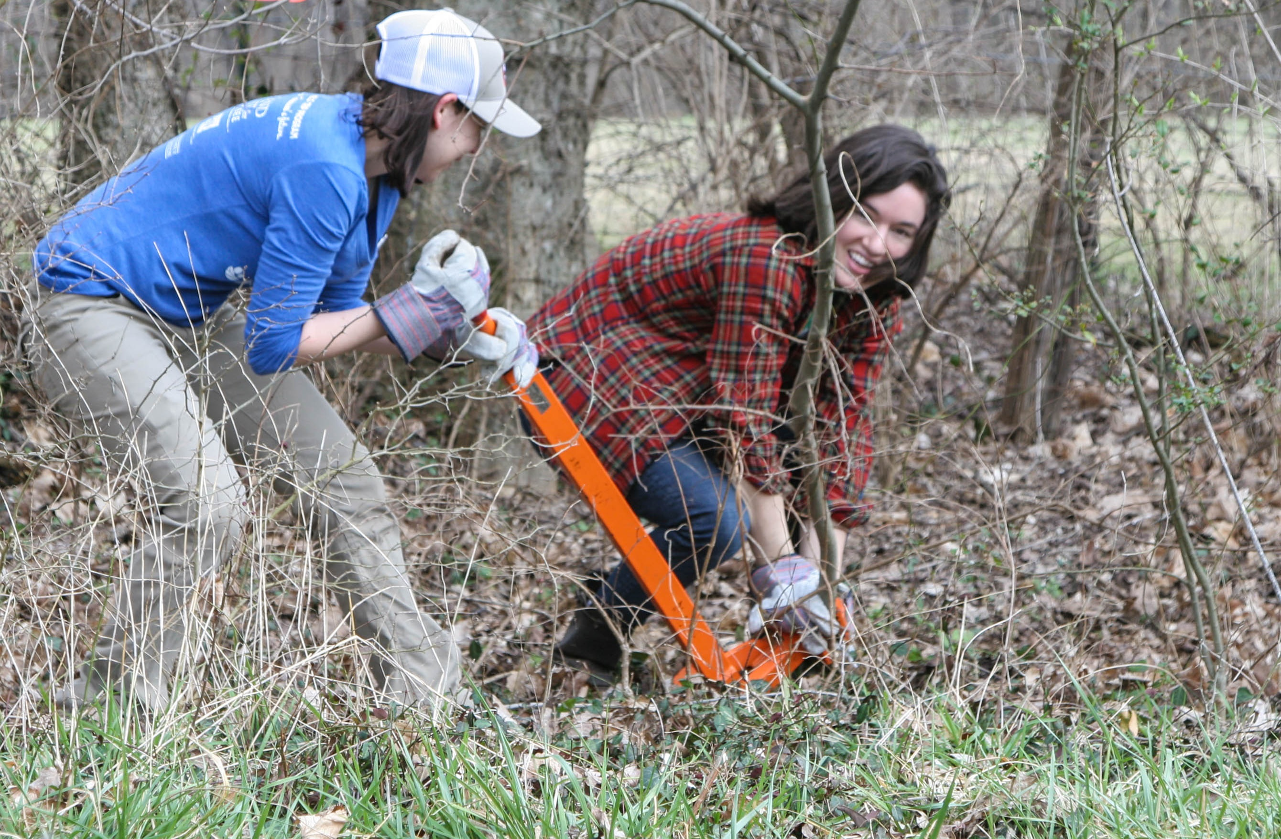
A Partners for Plants Initiative
Presented by Cayce McAlister
Garden Club of Nashville

Slide 2
Notes:
Weed Wrangle®, a collaborative network, is an example of action. Action, that supports the tenets of HR1054 …of plant conservation and restoration on public lands. We use the knowledge of Botanists and other horticultural experts to educate the volunteers, as to the benefits of the eradication of invasives and the benefit of replanting with natives. This knowledge is therefore implemented not only on public lands but the volunteer will take their new knowledge and enthusiasm to their own homes and continue the efforts there. So, let me take you back to the beginning…

Slide 3
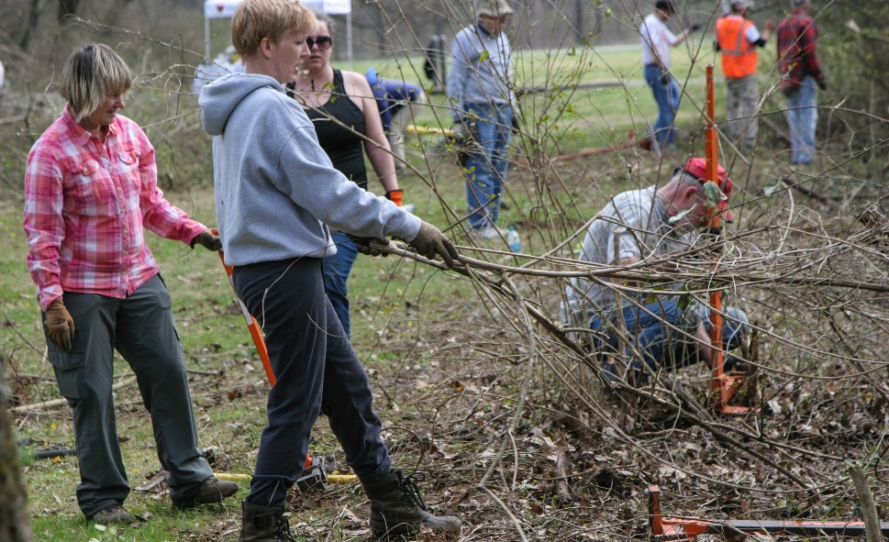
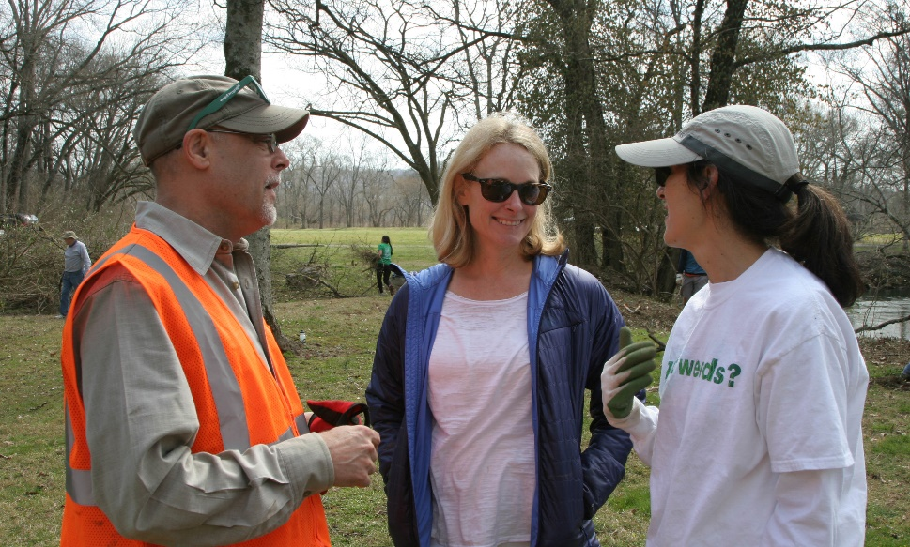
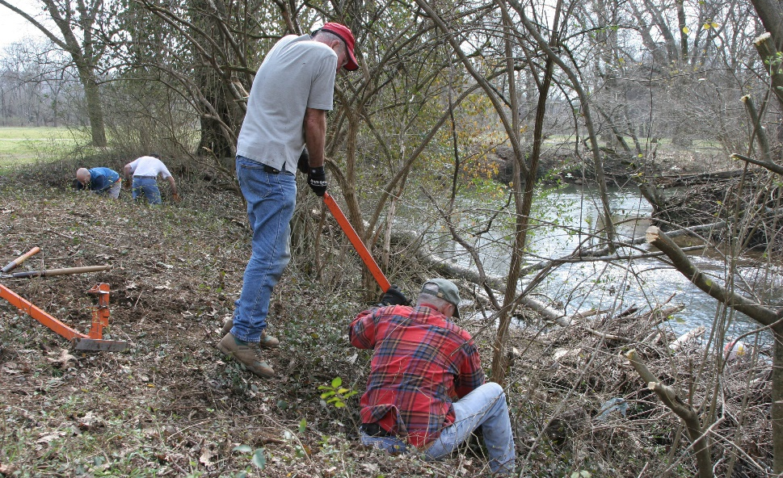
This action supports plant conservation and restoration on public lands
Weed Wrangle® is a collaborative network and an example of action
Notes:
As a lay person in the world of invasives, I have a conjured up memory in my head from my childhood. I remember being outdoors looking at the woods behind our house and I could see every tree trunk. Now, I can’t see any. I have a personal responsibility of my own and a shared responsibility with my community to use this new found advocacy for action.
Weed Wrangle® uses the knowledge of Botanists and other horticultural experts to educate the volunteers, as to the benefits of the eradication of invasives and the benefit of replanting with natives. This knowledge is therefore implemented not only on public lands but the volunteer will take their new knowledge and enthusiasm to their own homes and continue the efforts there.

Slide 4
The Garden Club of America
Launched in 1992
Since then, over 500 projects have been created
Example: Weed Wrangle®
A joint habitat restoration program of the Conservation and Horticulture Committees
Provides critical assistance and resources to park managers
Notes:
Partners for Plants
In 1992, The Garden Club of America launched a national program called Partners for Plants, a joint habitat restoration program of the Conservation and Horticulture Committees. Its purpose is to facilitate projects between local GCA clubs and land managers on federal, state, local and other significant public lands. Projects may include the monitoring and protection of rare, endangered and medicinal plants, the propagation and replanting of native plants and the removal of invasive plants. In cooperation with state and federal agencies, volunteers work to monitor and conserve rare plants, restore native habitats.
Using botanists and other horticultural experts, these programs provide critical assistance to park managers at a time when many public lands lack critical resources. Since the project was launched, Partners for Plants has spawned over 500 projects across the country.
One especially successful model is Weed Wrangle®.
GCA’s influence, over the years, has been especially pronounced in areas regarding plants and plant scientists. In 1997, in a meeting with Secretary of the Interior Bruce Babbitt, and then in ’98 and ’99, GCA called for more botanists in the federal workforce to ensure proper ecosystem management.

Slide 5
How It Started

Slide 6
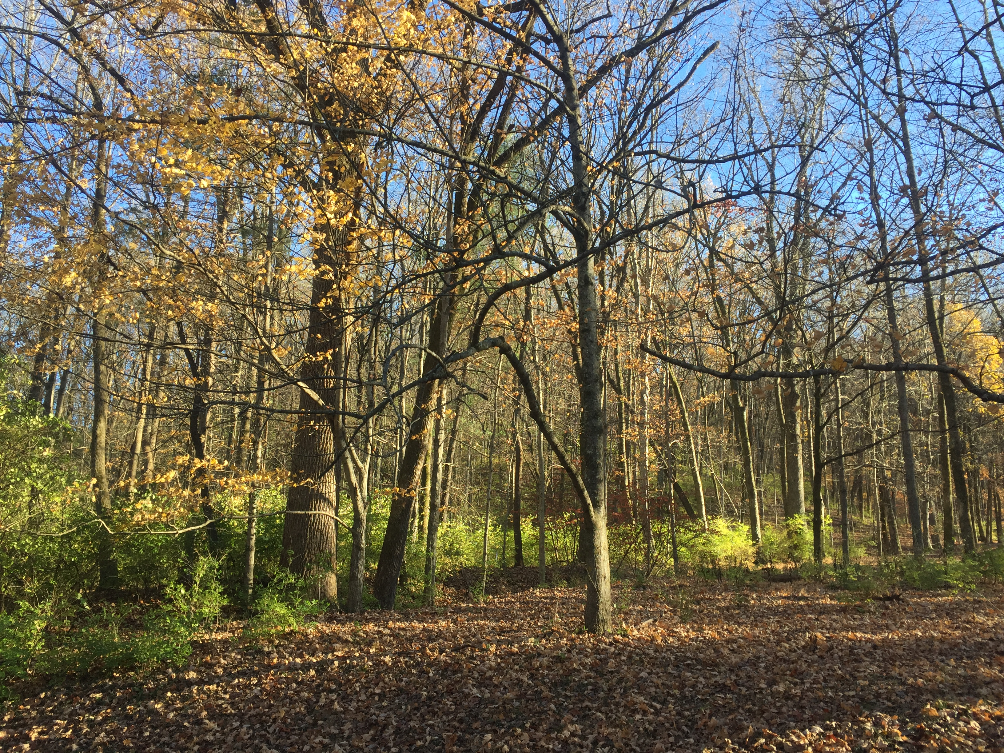
What Is All That Stuff?

Slide 7
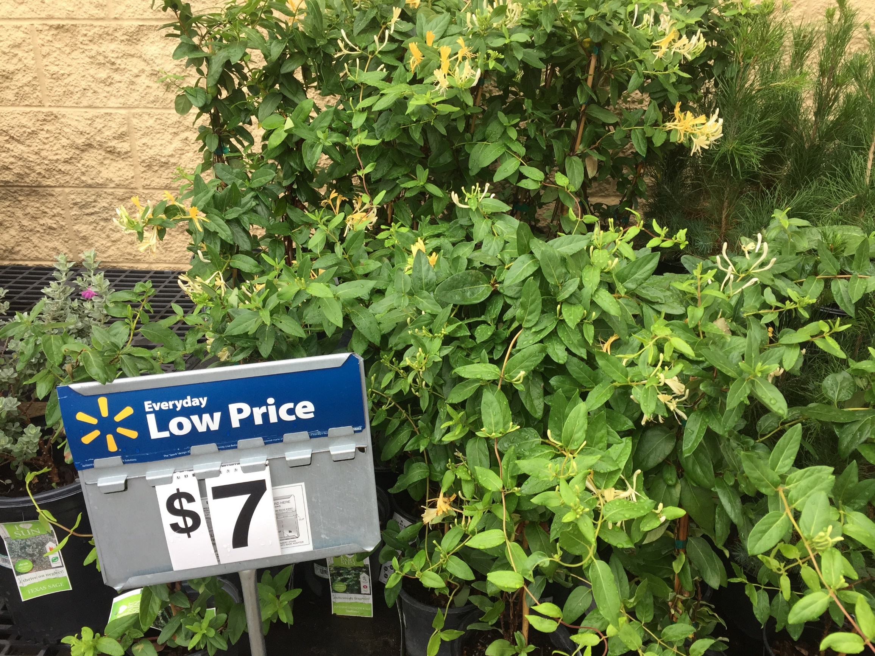
Mystery “Big Box”

Slide 8
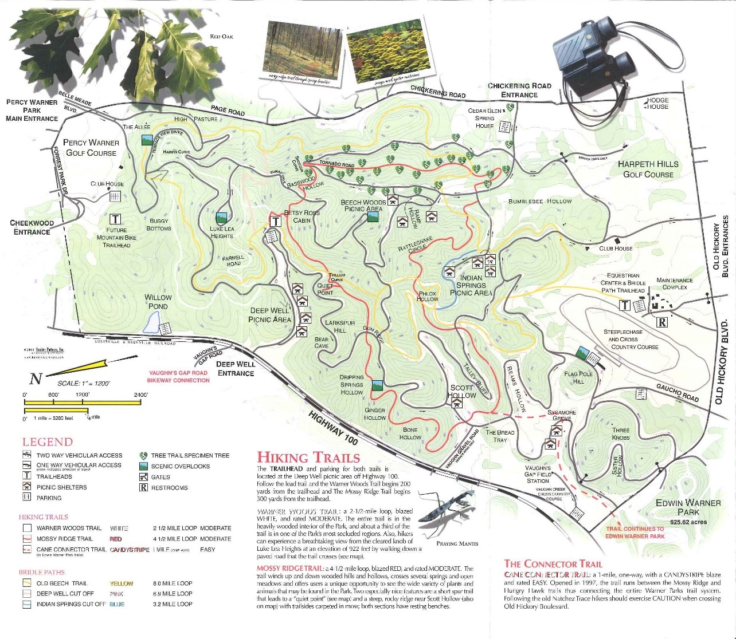
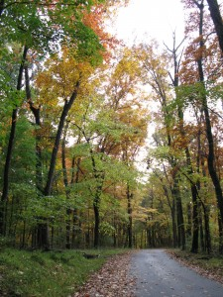
How it started
Warner Parks
Notes:
I was the brand new President of the Garden Club of Nashville, when I received a call from Georgia Schell from Portland, OR, the then P4P Vice Chair, saying that she and her husband Steve were coming to Nashville and wanted to see our P4P project. As we drove around the 3200 acre Warner Parks, a city park in Nashville, they kept asking,
“What is all that stuff?” They didn’t know Japanese Honeysuckle and Privet. Our invasives were not the same as their invasives in Oregon. They were shocked to see amount of it we had. They had no idea how destructive Japanese Honeysuckle and Privet could be. They said if you were to get it out of the park, it would still be across the street in that persons yard.

Slide 9
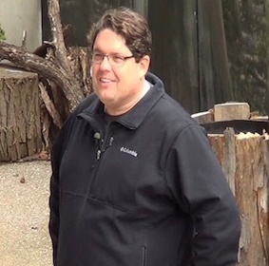
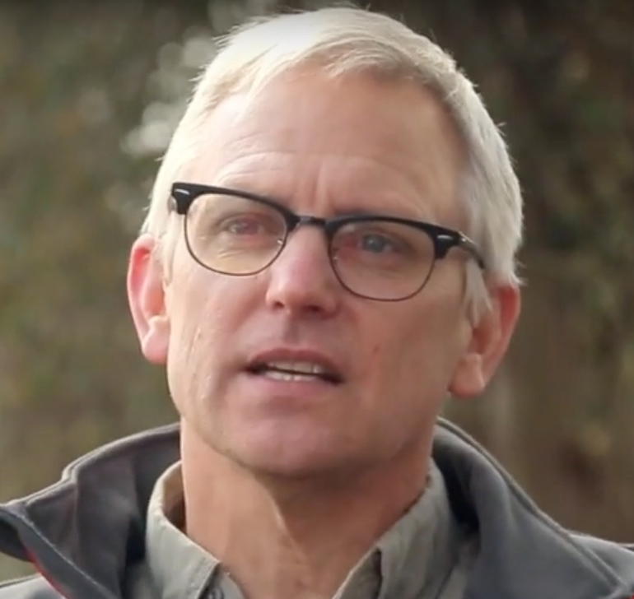
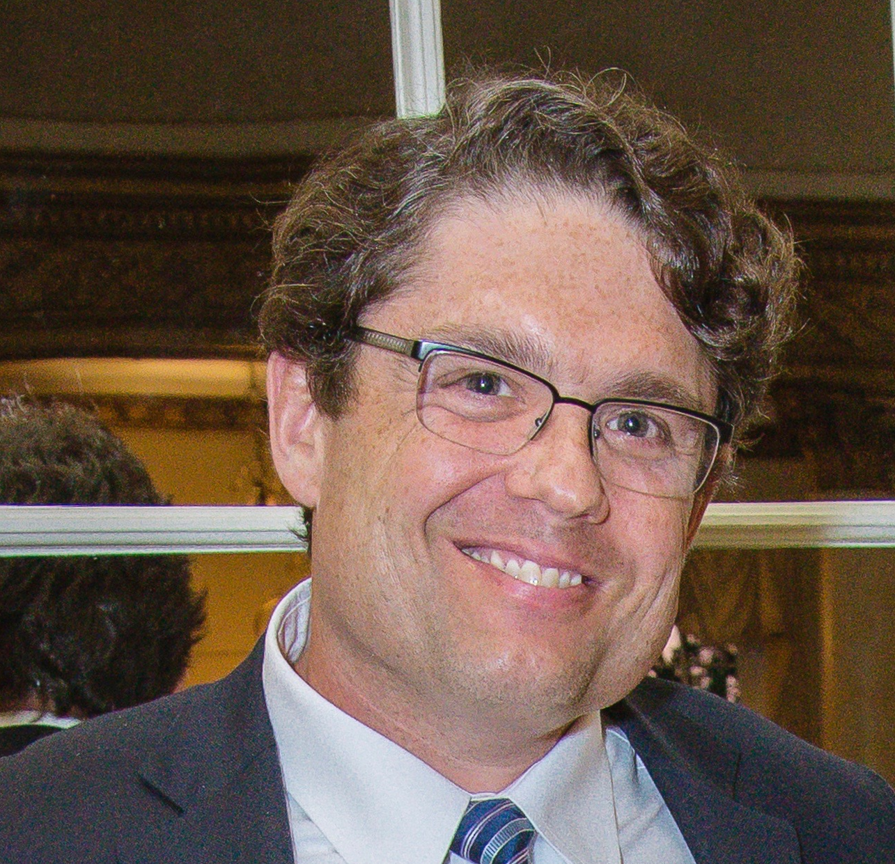
Secret Weapon
Steve Manning
Lee Patrick
Notes:
The idea was massaged through a series of conversations with The Warner Parks, Weed Wrangle® Co-Coordinator Elizabeth Lamar and our secret weapon, Steve Manning. Steve, who you all know, is a native Nashvillian and along with Lee Patrick, owner of Invasive Plant Control. During one of our many meetings, Steve said to us, “The Garden Club of America with it’s leadership abilities have engaged a target audience that professionals have not been able to educate.”

Slide 10
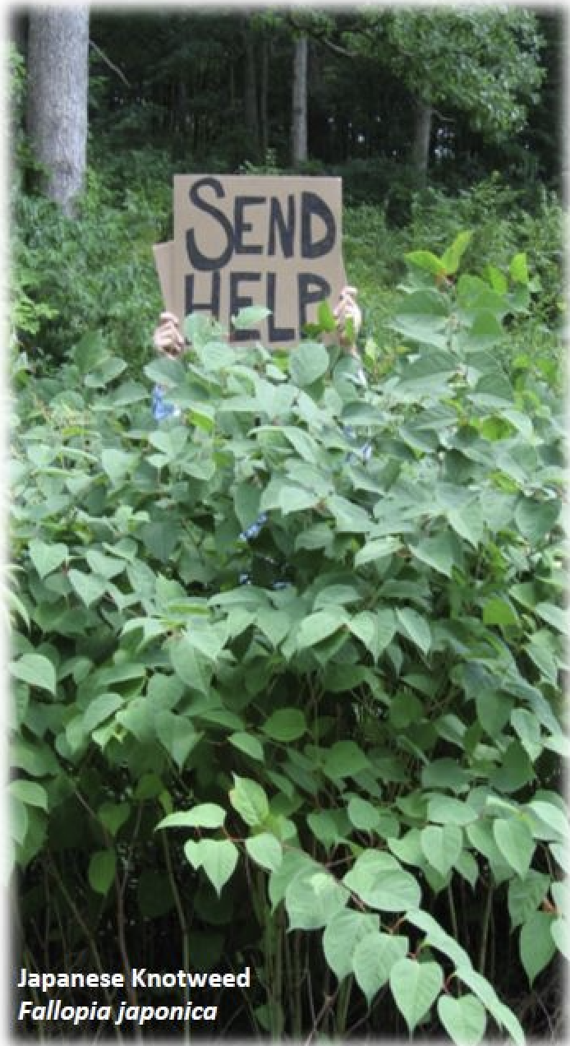
Not the experts!
Notes:
Fast forward 10 years, to hear Park leaders increasingly complain that they cannot find botanists and other plant scientists prepared to address the challenges caused by a rapidly changing environment. That’s why, in 2017, the Garden Club of America along with the Chicago Botanic Garden and 60 other distinguished organizations endorsed H.R.1054, familiarly known as the Botanical Sciences Bill, promoting the employment of botanists on public lands and the preservation of native plant materials.

Slide 11
“
“The Garden Club of America, with it’s leadership abilities, have engaged a target audience that professionals have not been able to educate.”
– Steve Manning
Notes:
We quickly realized that partnerships/collaboration were the only answer…
So idea for the Weed Wrangle® was born that October day in 2013. My sister-in-law, a songwriter, thought of the name Weed Wrangle® and a friend of my daughters designed the logo and the GCNashville trademarked the name. It was our first collaborative effort!
Steve went on to say, “Collaboration through community partnerships is the answer to eradication of invasives and the renewal of natives.” Steve Manning and Lee Patrick have been instrumental in the development of Weed Wrangle®. They have challenged us, they have lead us with passion for the project, they have educated us and they encouraged us.
So, in a nut shell, that is what we did.

Slide 12
Different voice
Same message
Notes:
When he made that statement, I was not really sure what he meant? You mean everybody does not understand? So we realized that education had to be a factor in eradication. Different voice, same message.

Slide 14
“
“Collaboration through community partnerships is the answer to eradication of invasives and the renewal of natives.”
– Steve Manning
Notes:
We quickly realized that partnerships/collaboration were the only answer…
So idea for the Weed Wrangle® was born that October day in 2013. My sister-in-law, a songwriter, thought of the name Weed Wrangle® and a friend of my daughters designed the logo and the GCNashville trademarked the name. It was our first collaborative effort!
Steve went on to say, “Collaboration through community partnerships is the answer to eradication of invasives and the renewal of natives.” Steve Manning and Lee Patrick have been instrumental in the development of Weed Wrangle®. They have challenged us, they have lead us with passion for the project, they have educated us and they encouraged us.
So, in a nut shell, that is what we did.

Slide 15
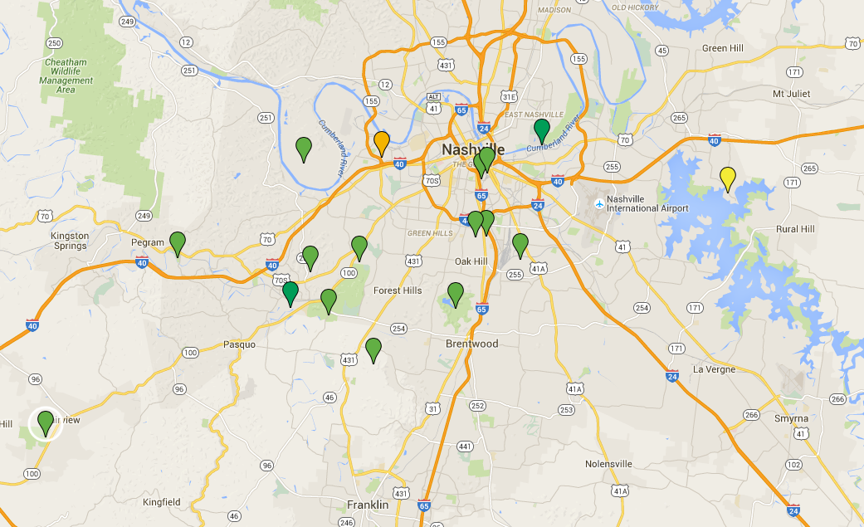
Sites Exist Everywhere

Slide 16
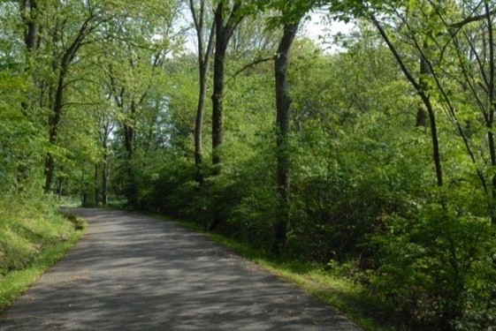
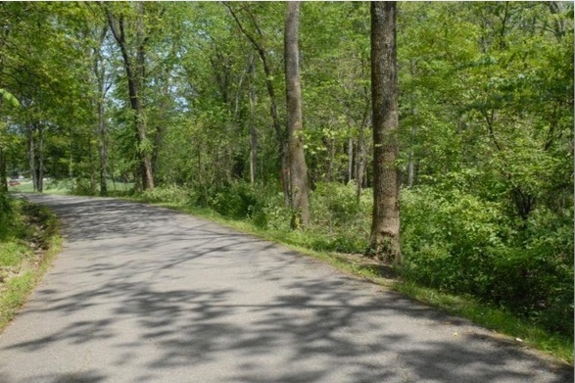
What we do
A one-day, citywide, volunteer effort to help rescue our public parks and green spaces from invasive species through hands-on removal of especially harmful trees, vines and flowering plants
BEFORE
AFTER
Remove Invasives, Restore Natives
Notes:
A one-day, citywide, volunteer effort to help rescue our public parks and green spaces from invasive species through hands-on removal of especially harmful trees, vines and flowering plants.
We use the knowledge of Botanists and other horticultural experts to educate the volunteers, as to the benefits of the eradication of invasives and the benefit of replanting with natives. This knowledge is therefore implemented not only on public lands but the volunteer will take their new knowledge and enthusiasm to their own homes
and continue the efforts there.
So, let me take you back to the beginning…

Slide 17
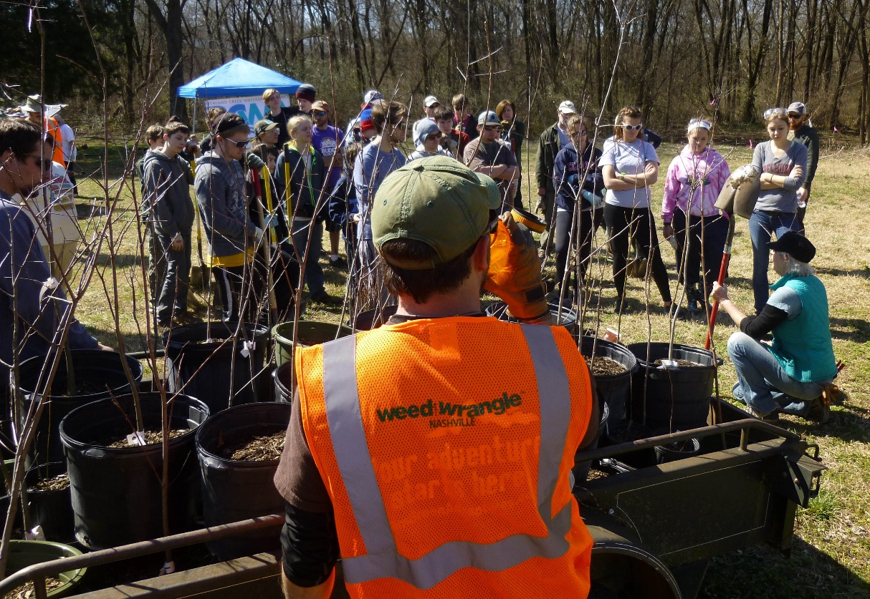
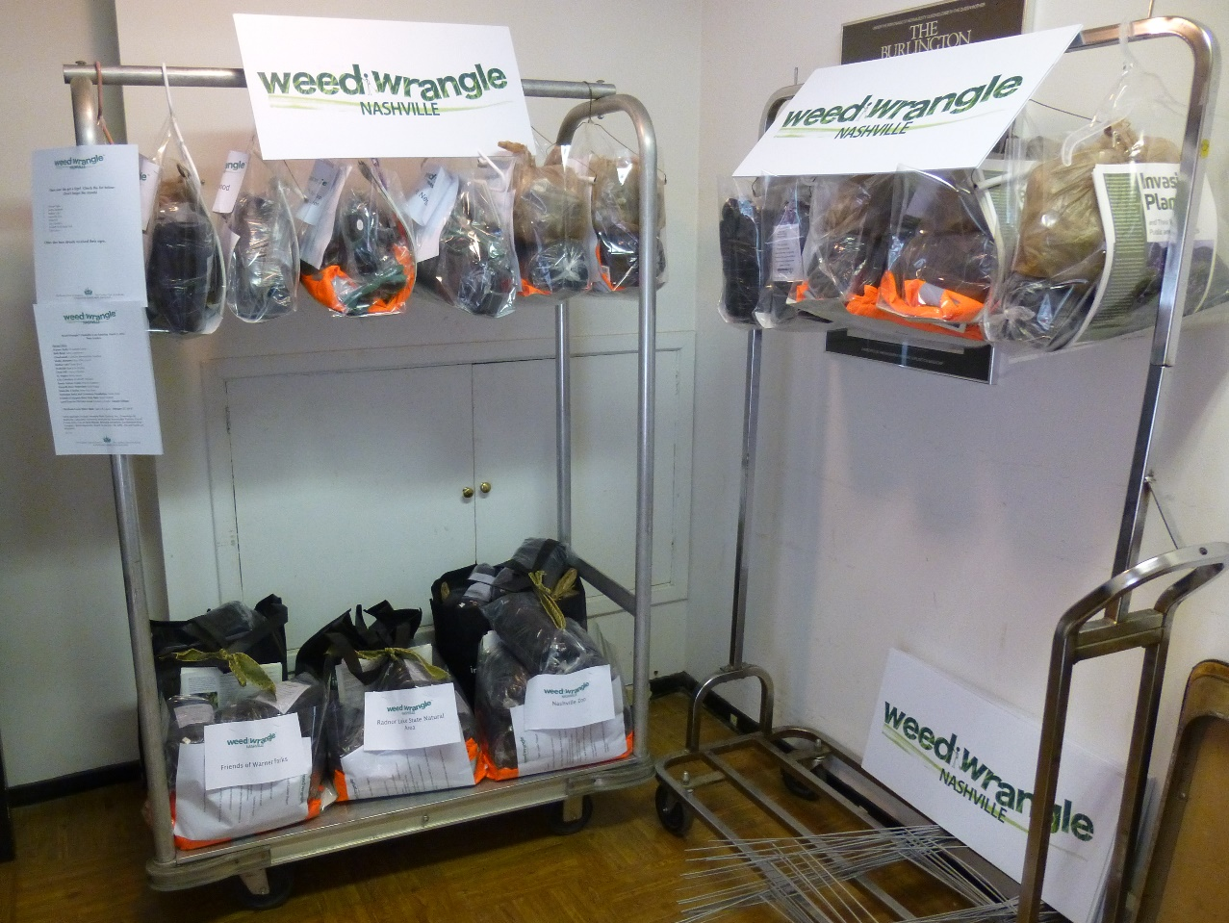
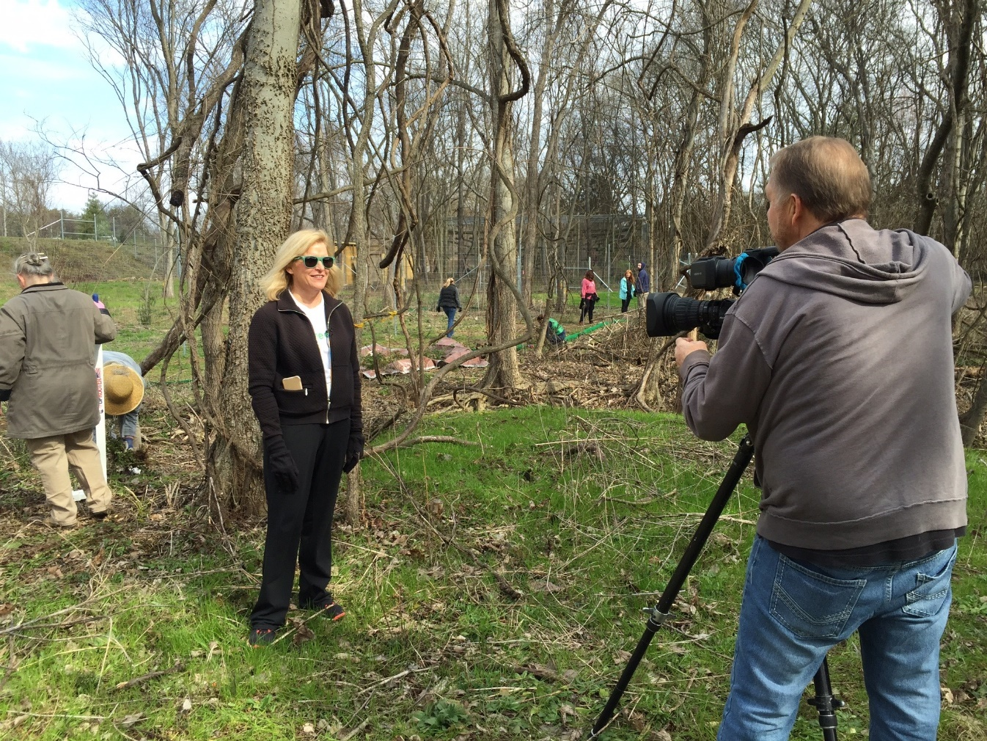
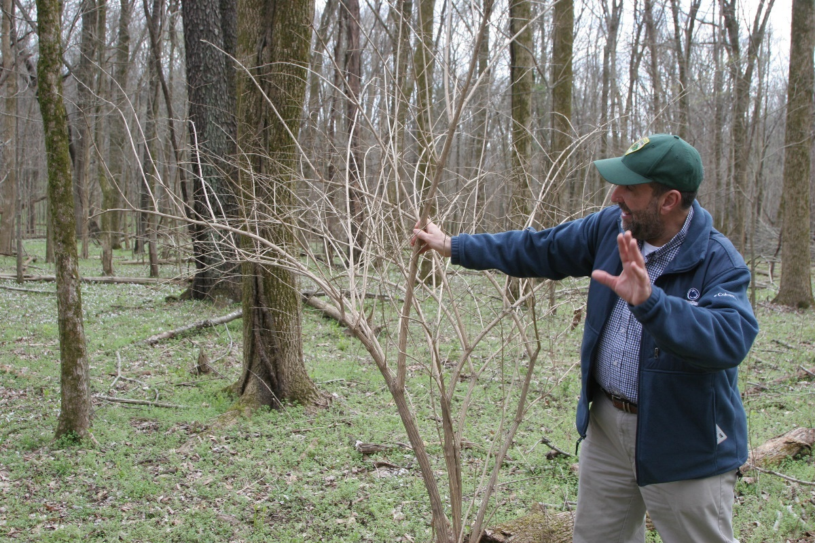
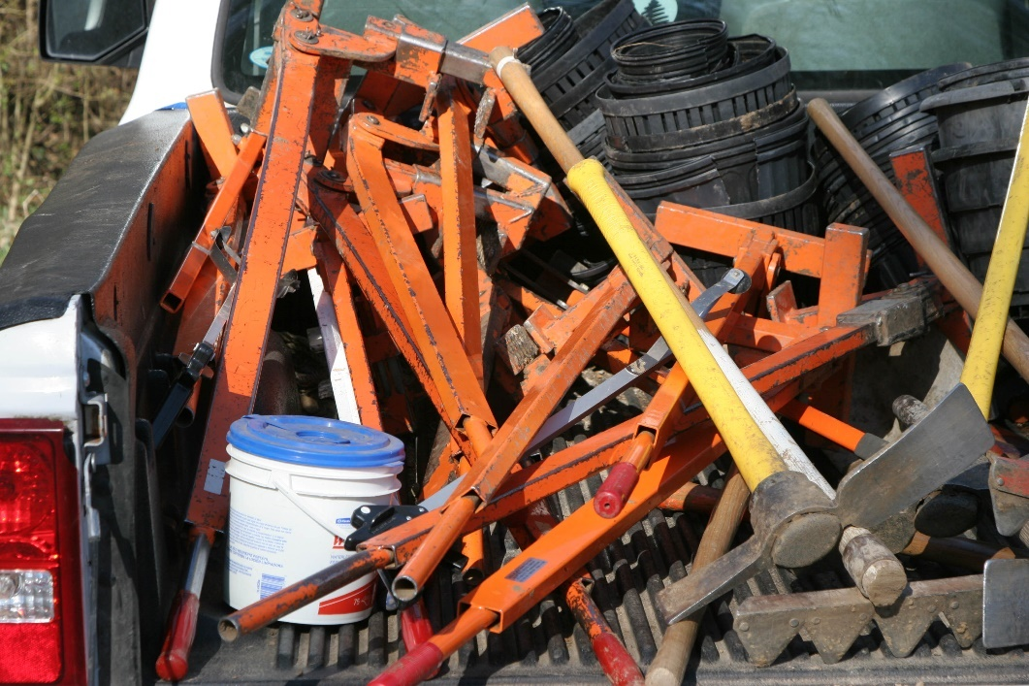
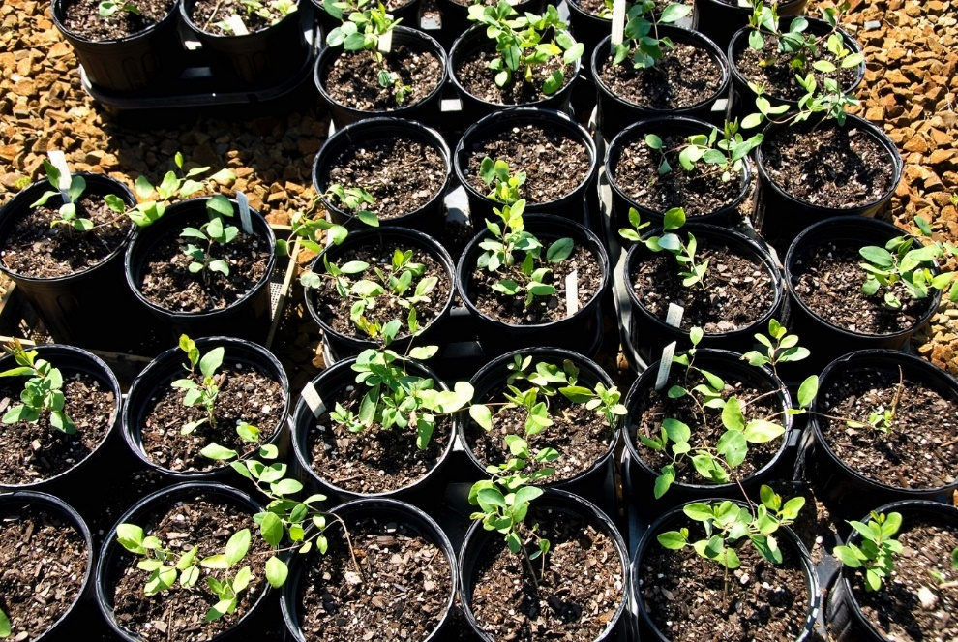
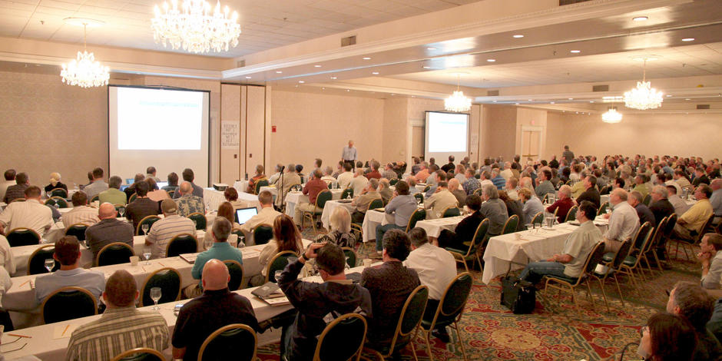
Notes:
We learned from the Warner Park Volunteer coordinator, Paul Fowler, that invasive weed pulls are already going on in a lot of our parks. So we scheduled a meeting with all the Volunteer Coordinators from public parks and green spaces in Nashville, to pitch the idea of a one day, collaborative effort, under the umbrella of Weed Wrangle®. Same thing everyone had been doing their own but now hosting the eradication events on the same day, city wide, with a media blitz.
Partnerships were formed and teamwork developed.
Every organization had something to offer: logistical concepts, tool banks, volunteers, promotional swag, training, education, social media abilities, and plenty of invasives!
Some are propagating their own plants and others are applying for grants and soliciting donations. Some are also planting native trees. All are actions for the greater good.
One of the most important ingredients for a successful Weed Wrangle® is the enthusiastic and whole-hearted involvement of every party involved in the process. Even in environmental agencies and organizations there are vast differences in knowledge about the issues and threats posed by invasive plants. At every stage of the event we work to educate. We are always conscious of delivering a clear message to our partner agencies, our media outlets, and the public. We provided city wide publicity, which we think is important to spreading the word, not just about the event but also about the problem. Every site handed out educational literature that we got from the State of TN, TN Exotic Pest Plant Council, Invasive.org and from the newly formed TN Plant Conservation Alliance.
We also feel as though community education is a very important component for success. We have hosted Community Meetings in partnership with Belmont University and also hosted a Weeds in the Woods Hike at Radnor Lake State Natural Area with a Dr. Robert Loeb,a visiting professor from Penn State University studying the ecosystem at Radnor Lake.

Slide 18
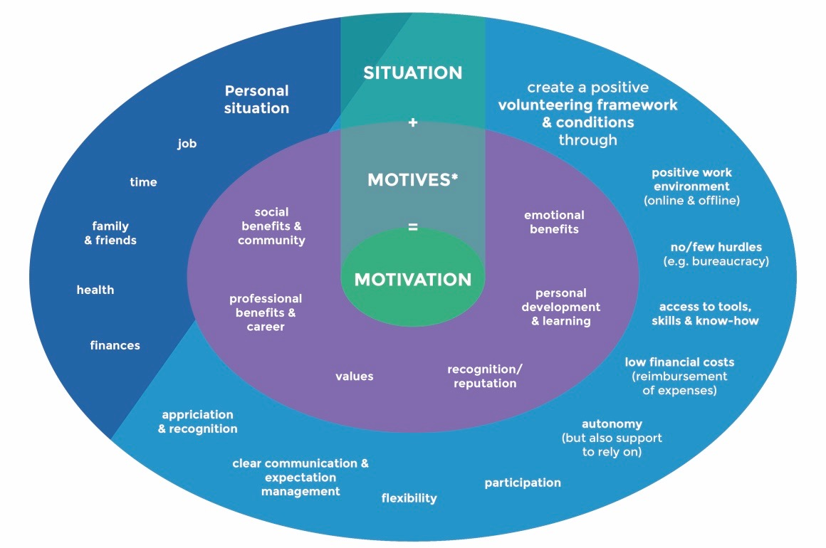
Social Psychology

Slide 19
Collaboration
Networks
Notes:
Social Psychology
The older I get the more I realize that we all think differently. Everyone has something to offer. I am a social worker by profession, and social psychology is my subject. I believe that Weed Wrangle® is an example of social psychology put into practice. Specifically these two words:
Collaboration and Network.
Collaboration is the name of the game. When many people work together towards a common goal, a sense of belonging to a greater community improves your motivation, health, and happiness. Having a sense of belonging is a common experience. Belonging means acceptance as a member or part. Collaboration, such a simple word for huge concept.
Effective collaboration requires good relationships to be established between people undertaking the work. Teamwork, Relationships, Crowd Mentality,
all the while being part of a group, and working together toward the common good.
Networks are the building blocks of social capital. They bring people together with a sense of common purpose based on shared values and identity. They also enable us to exchange information, debate and discuss matters, and give and receive support.

Slide 21
Collaboration
Networks
Notes:
Social Psychology
The older I get the more I realize that we all think differently. Everyone has something to offer. I am a social worker by profession, and social psychology is my subject. I believe that Weed Wrangle® is an example of social psychology put into practice. Specifically these two words:
Collaboration and Network.
Collaboration is the name of the game. When many people work together towards a common goal, a sense of belonging to a greater community improves your motivation, health, and happiness. Having a sense of belonging is a common experience. Belonging means acceptance as a member or part. Collaboration, such a simple word for huge concept.
Effective collaboration requires good relationships to be established between people undertaking the work. Teamwork, Relationships, Crowd Mentality,
all the while being part of a group, and working together toward the common good.
Networks are the building blocks of social capital. They bring people together with a sense of common purpose based on shared values and identity. They also enable us to exchange information, debate and discuss matters, and give and receive support.

Slide 22
Is a collaborative network
Opportunities and places for people to meet
Links organizations with common interests
Puts people in touch with each other
Helps people stay connected
Promotes teamwork and community
Notes:
Weed Wrangle® is a collaborative network.
It provide opportunities for people to meet,
Provides places for people to meet,
Links organizations with common interests,
Puts people in touch with each other, and
Helps people to stay connected.
Everyone loves being part of a team with team goals and collaborative networks. Volunteerism for environmental change is fun! People generally look to help; all you have to do is ask! By building this volunteer support, it gives community members ownership in the project and true interest in the public land... If you work it, you own it!
By engaging our volunteers and challenging them to learn about the topic and to take action in their own spaces, our goal became to create a collaborative network that will have the greatest impact on invasive plant populations.

Slide 23
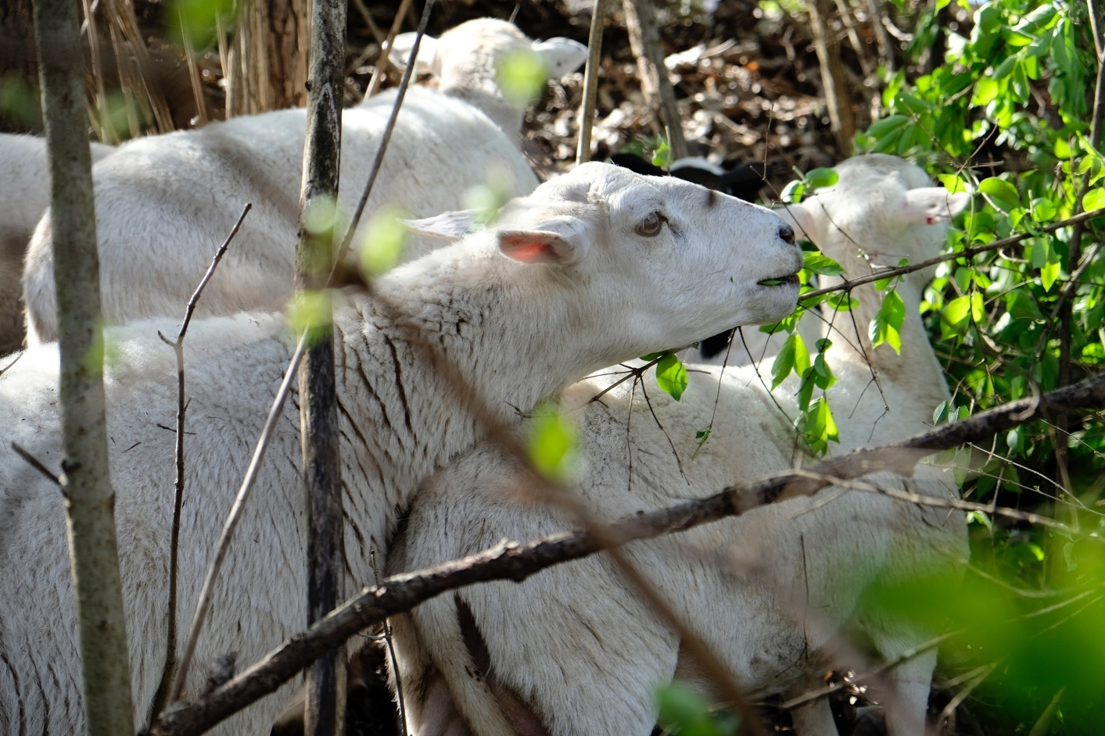
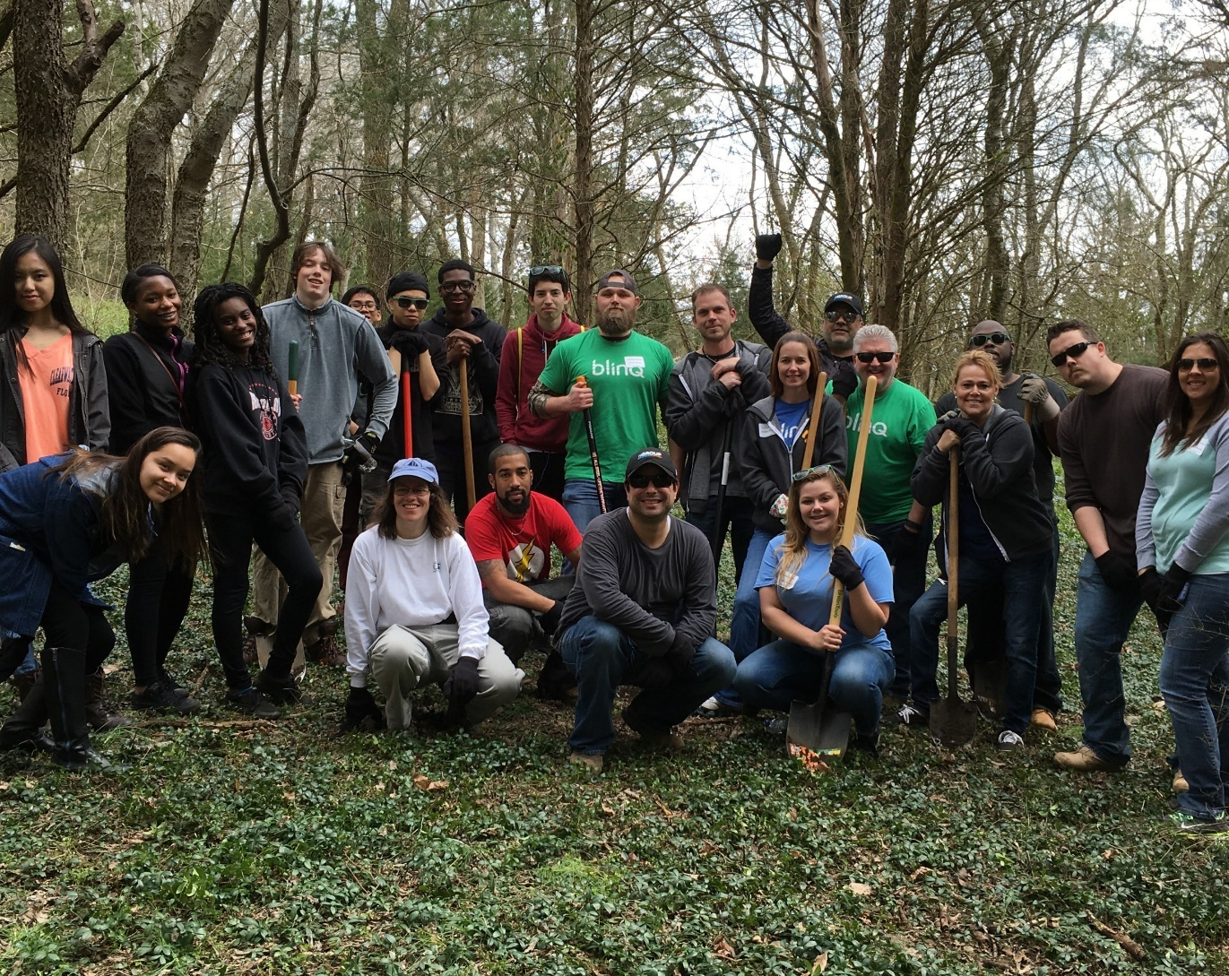
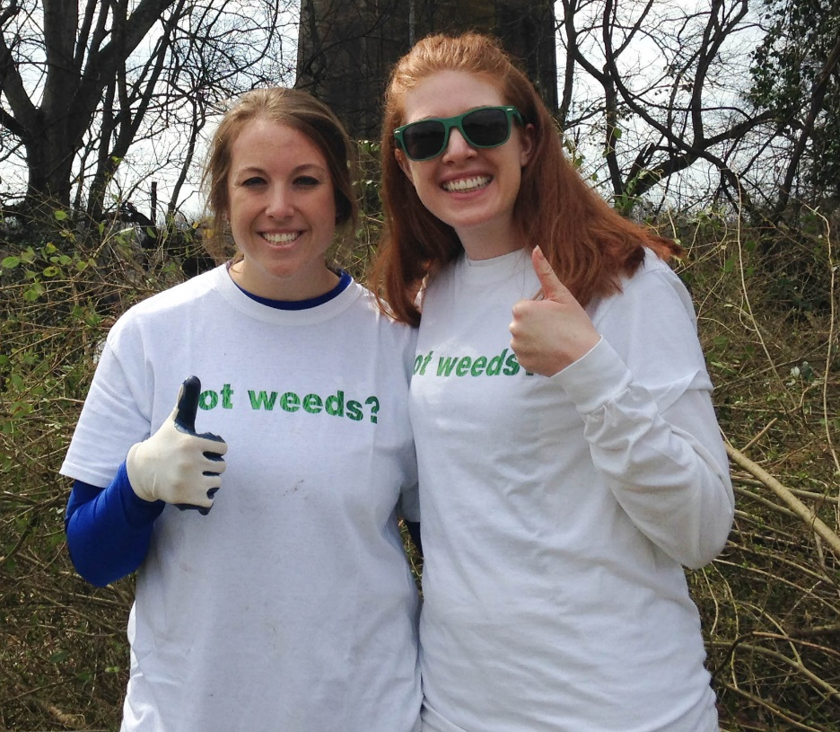
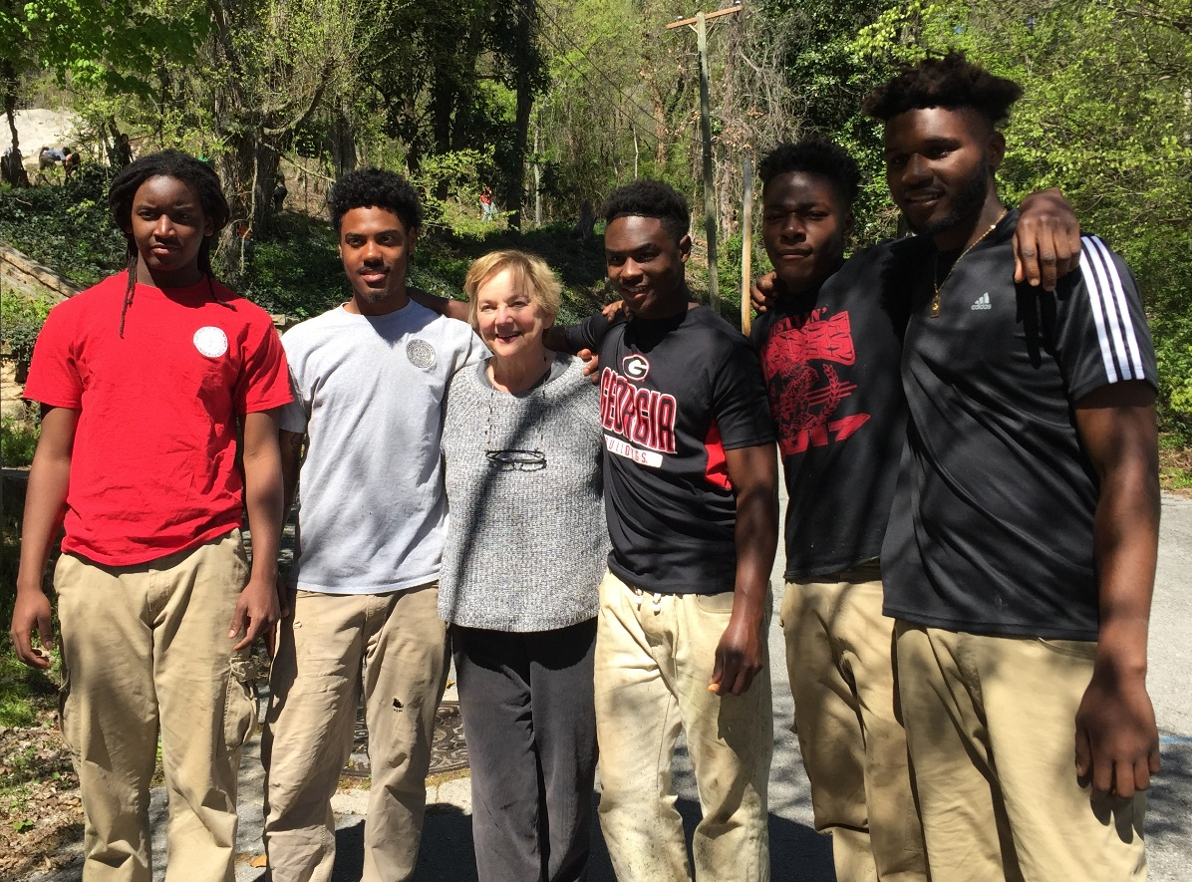
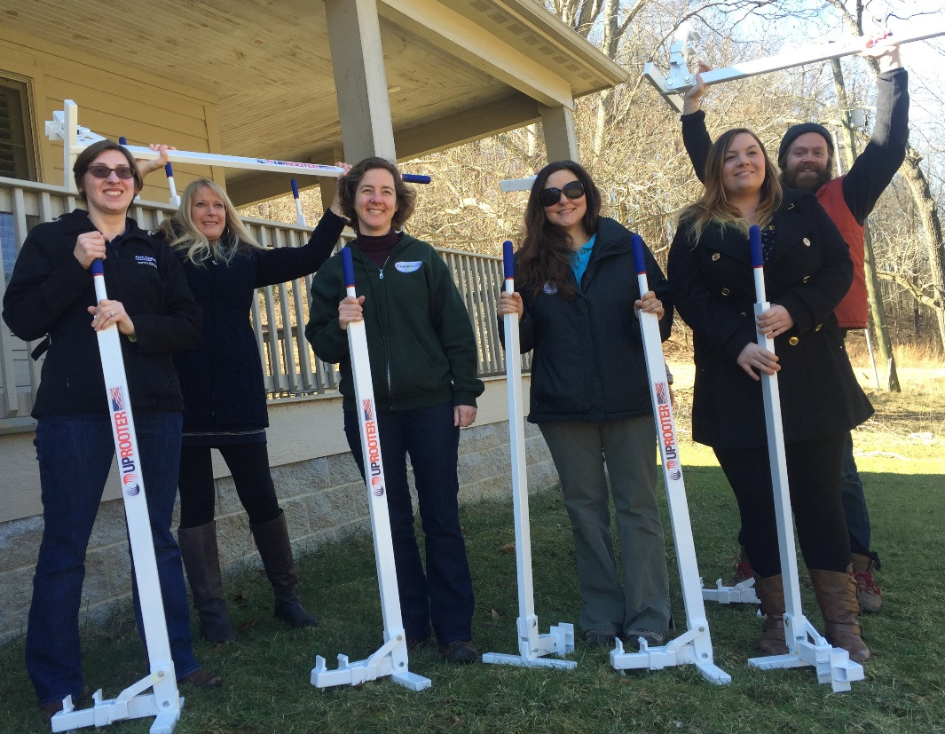
Our Volunteers
Notes:
We are not proud, we will recruit any ole ewe.

Slide 24
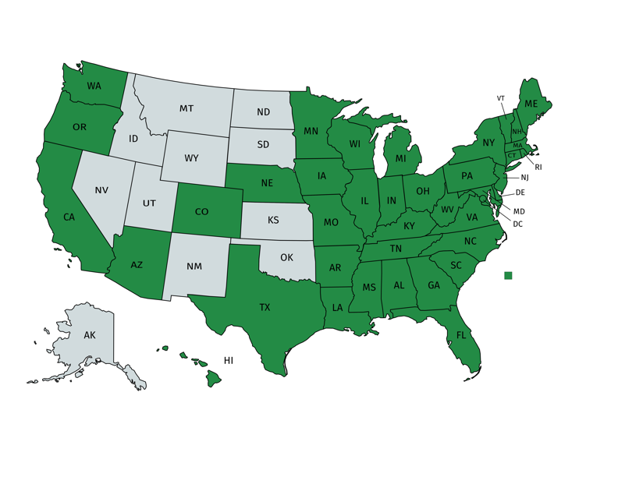
Founded in
1913
201 Clubs
Nationwide
10 Position Papers
To promote greater understanding of interdependence of horticulture, environmental protection and community improvement
Clean Air
Clean Water
Climate Change
National Parks
National Public Lands
Native Plants
Oceans
Sustainable Agriculture, Seed Diversity and Food Security
Transportation and Infrastructure
Waste Management
With 18,000 members, 28 merit-based scholarships and fellowships, and more than $330k awarded to 65 scholars in 2018

Slide 25
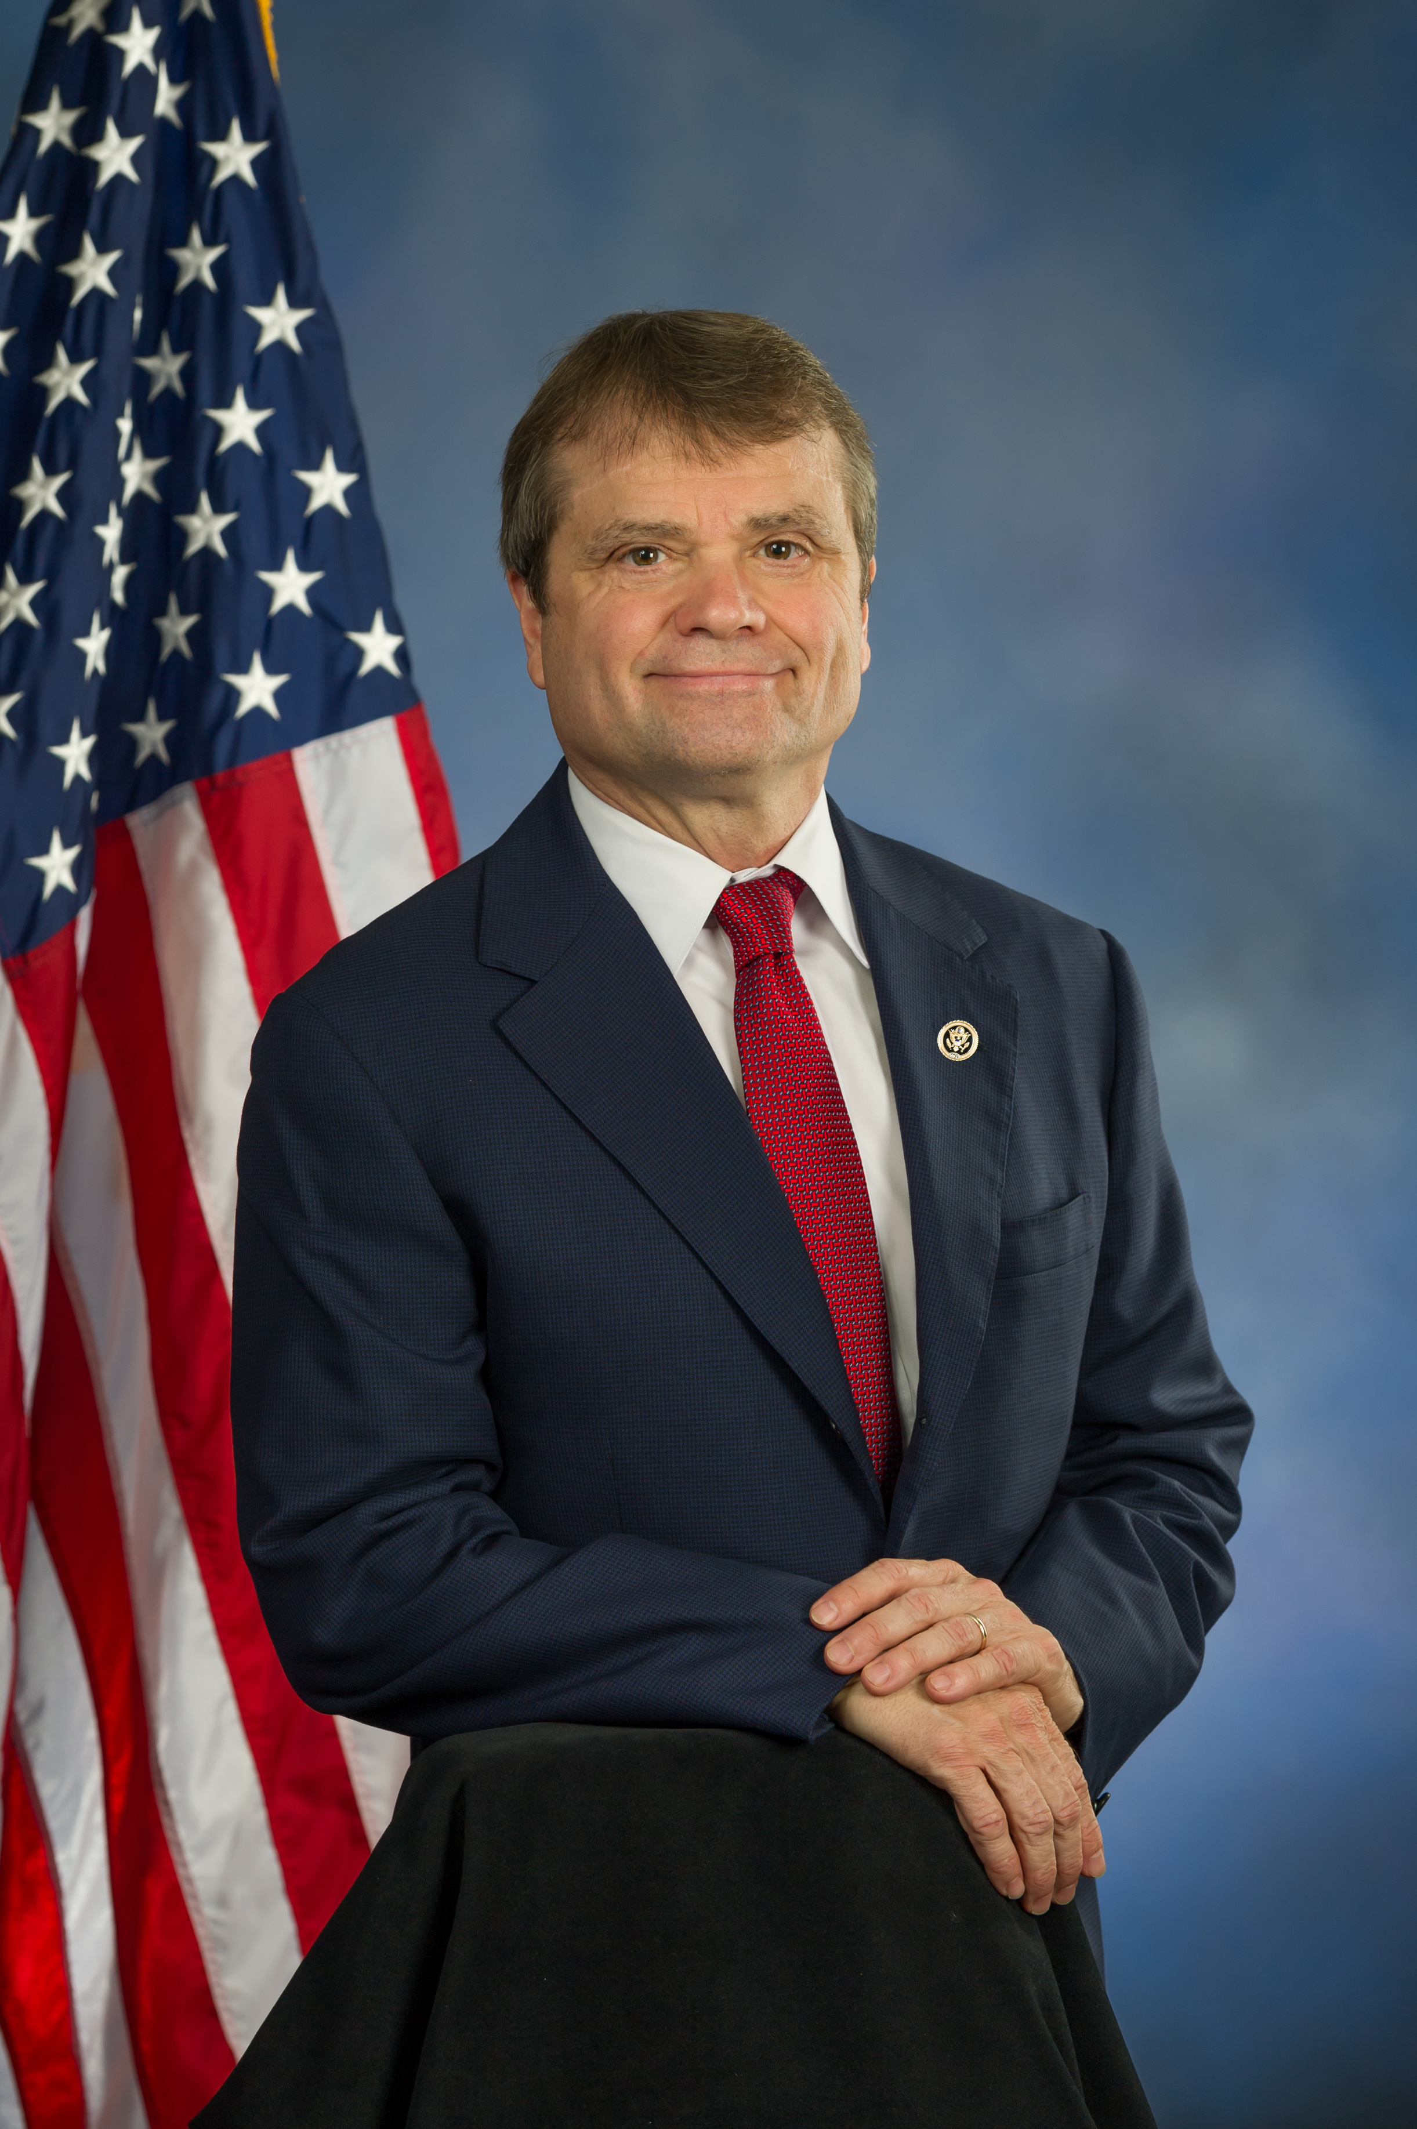
“The country is projected to lose nearly half of its botanical expertise in the next decade.”
Rep. Francis Rooney (R-FL)
Rep. Mike Quigley (D-IL)
“The Bureau of Land Management employs just over 1 botanist per 4 million acres managed.”
https://botanybill.weebly.com

Slide 26
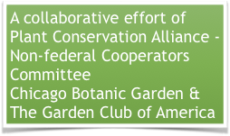
HR 1572

Slide 27
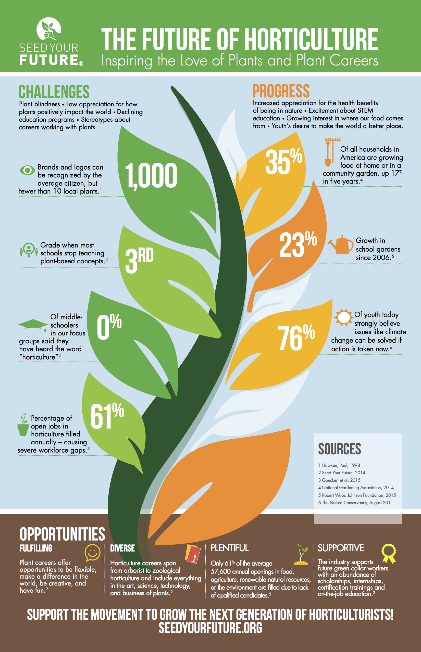
Seed Your Future
Mission
To promote horticulture and inspire people to pursue careers working with plants.
A few of the alarming statistics:
The average U.S. citizen can identify more than 1,000 brands and logos, but fewer than 10 local plants.
Most schools stop teaching plant-based concepts in the third grade.
ZERO middle-schoolers in focus groups across the country said they have heard the word “horticulture.”
helps with that!

Slide 28
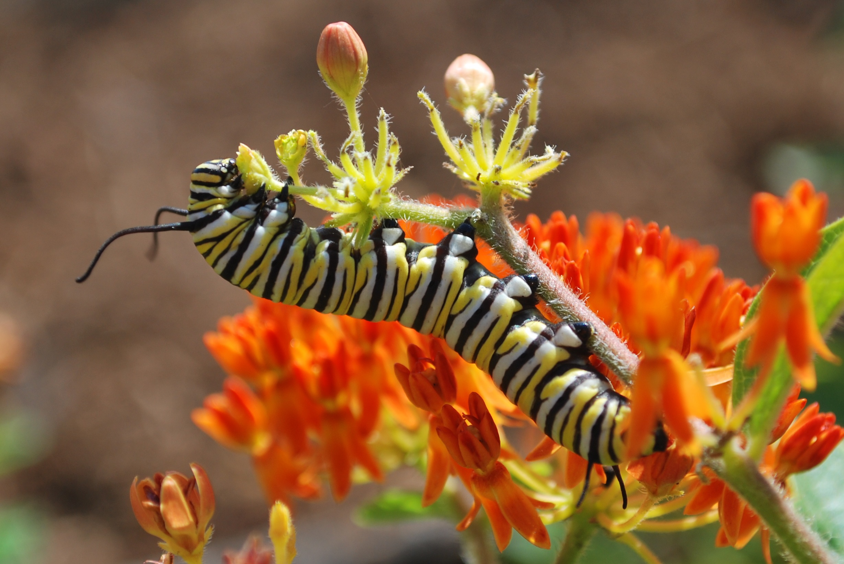
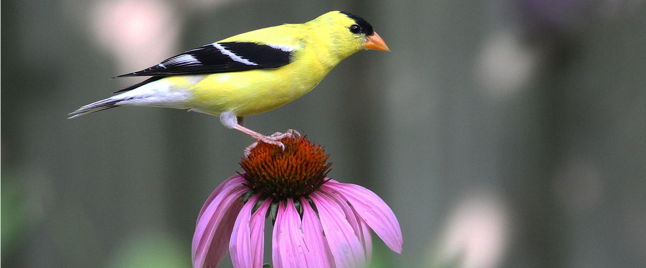
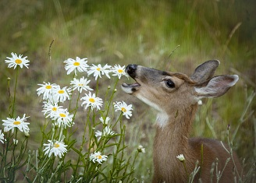
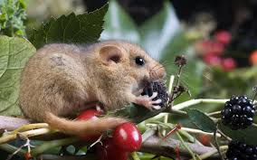
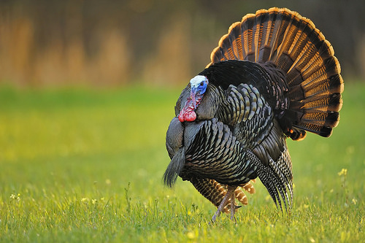
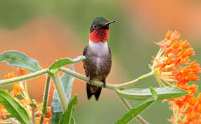
A threat to Native Plants
is a threat to Native Wildlife
Notes:
A one-day, citywide, volunteer effort to help rescue our public parks and green spaces from invasive species through hands-on removal of especially harmful trees, vines and flowering plants.
We use the knowledge of Botanists and other horticultural experts to educate the volunteers, as to the benefits of the eradication of invasives and the benefit of replanting with natives. This knowledge is therefore implemented not only on public lands but the volunteer will take their new knowledge and enthusiasm to their own homes
and continue the efforts there.
So, let me take you back to the beginning…

Slide 29
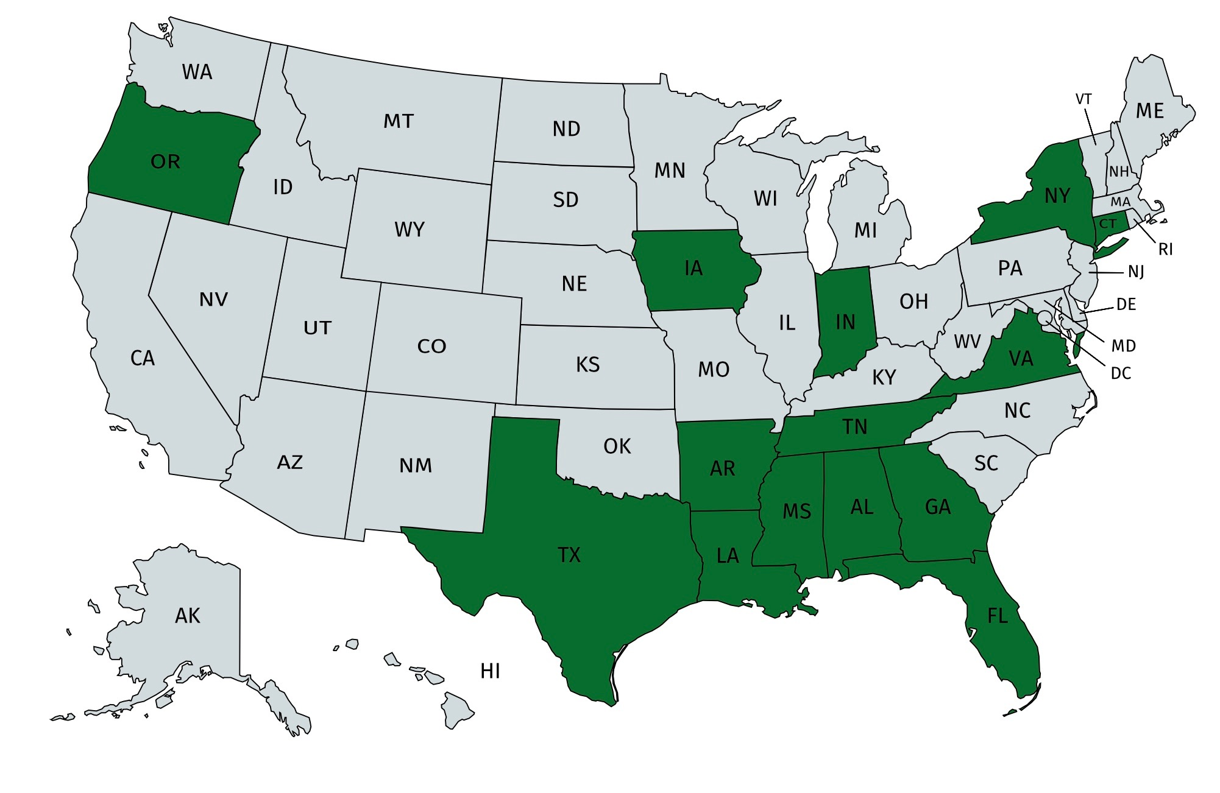
Our Progress
Year 1
Year 3
Today
Expansion Nationwide
Tennessee
Louisiana
Mississippi
Texas
Oregon
Florida
Alabama
Indiana
Georgia
Virginia
New York
Connecticut
Iowa
Thousands of Volunteers in over 100 cities
Nashville Only
10 Public Parks
500 Volunteers
1,300 Hours
Expansion in Tennessee
2X Partners in Nashville
Memphis, Knoxville, Chattanooga
34 TN StateParks/Natural Areas
1 National Park
3000+ Volunteers

Slide 30
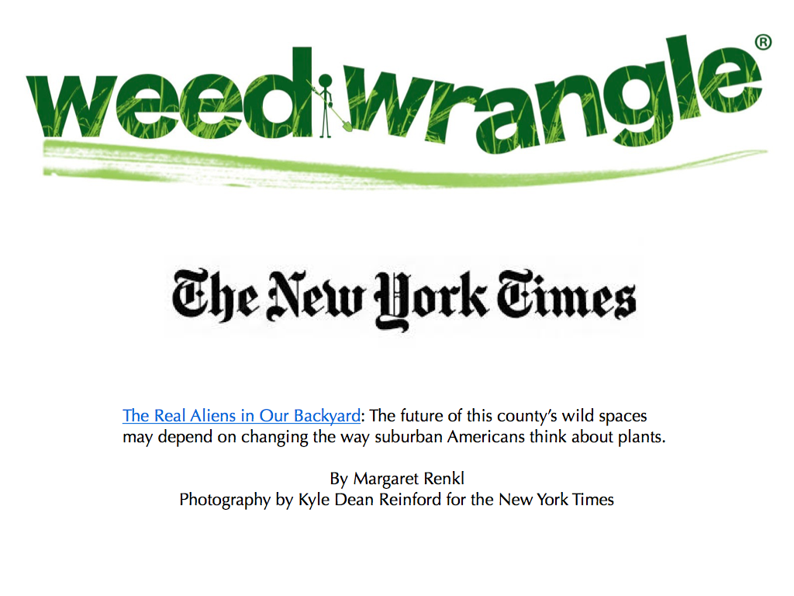
March 11, 2019

Slide 31
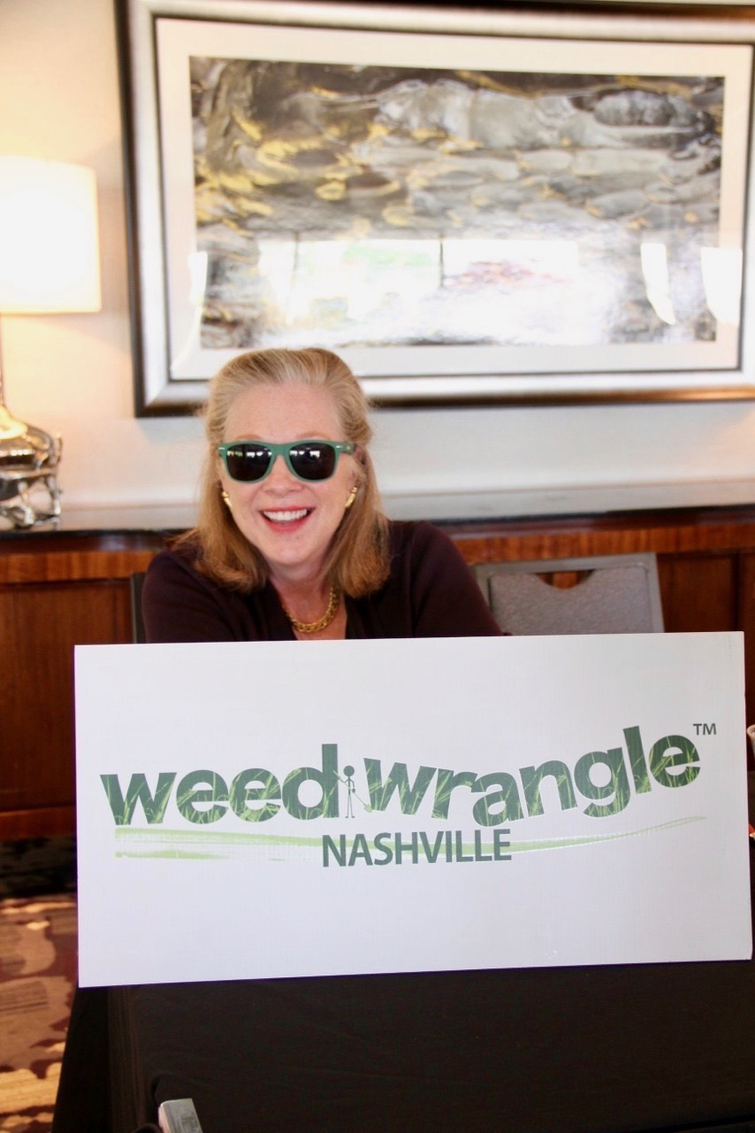
Weeds ruin your eyeballs
Forever!

Slide 32
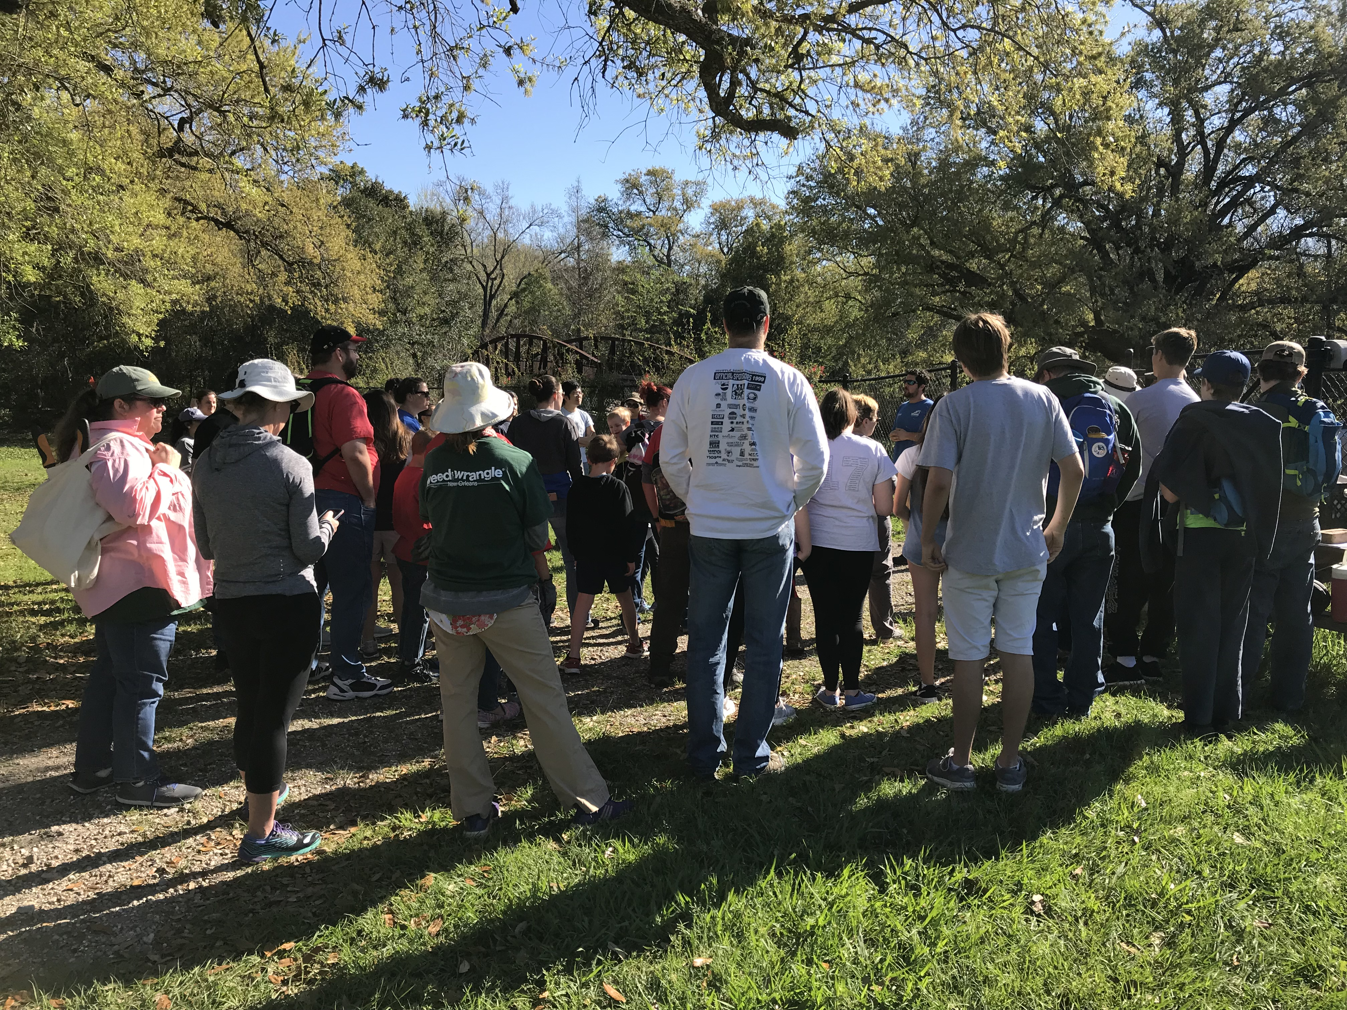
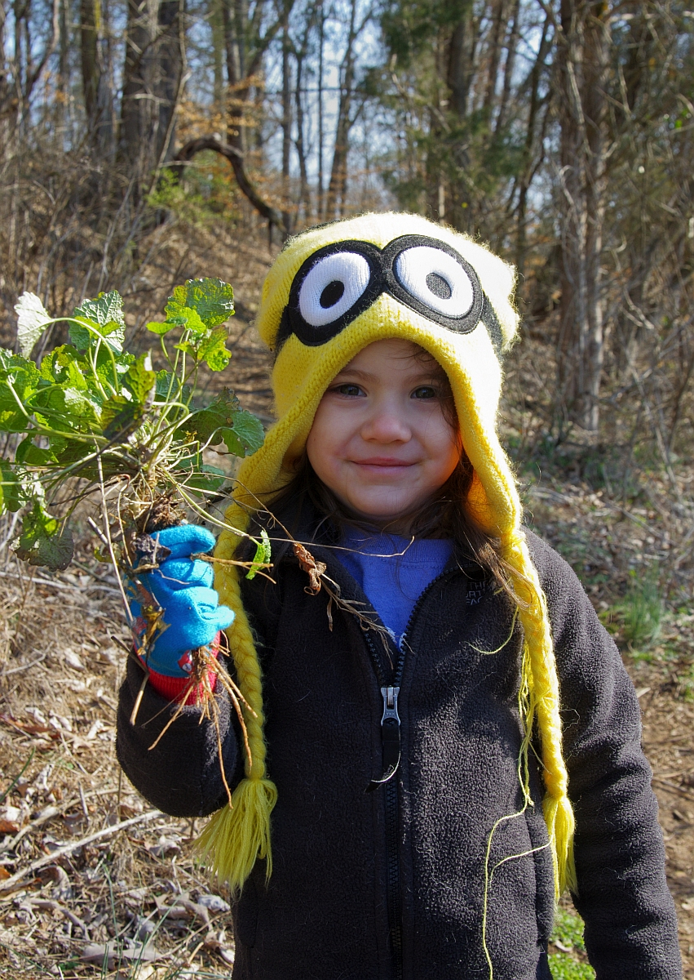
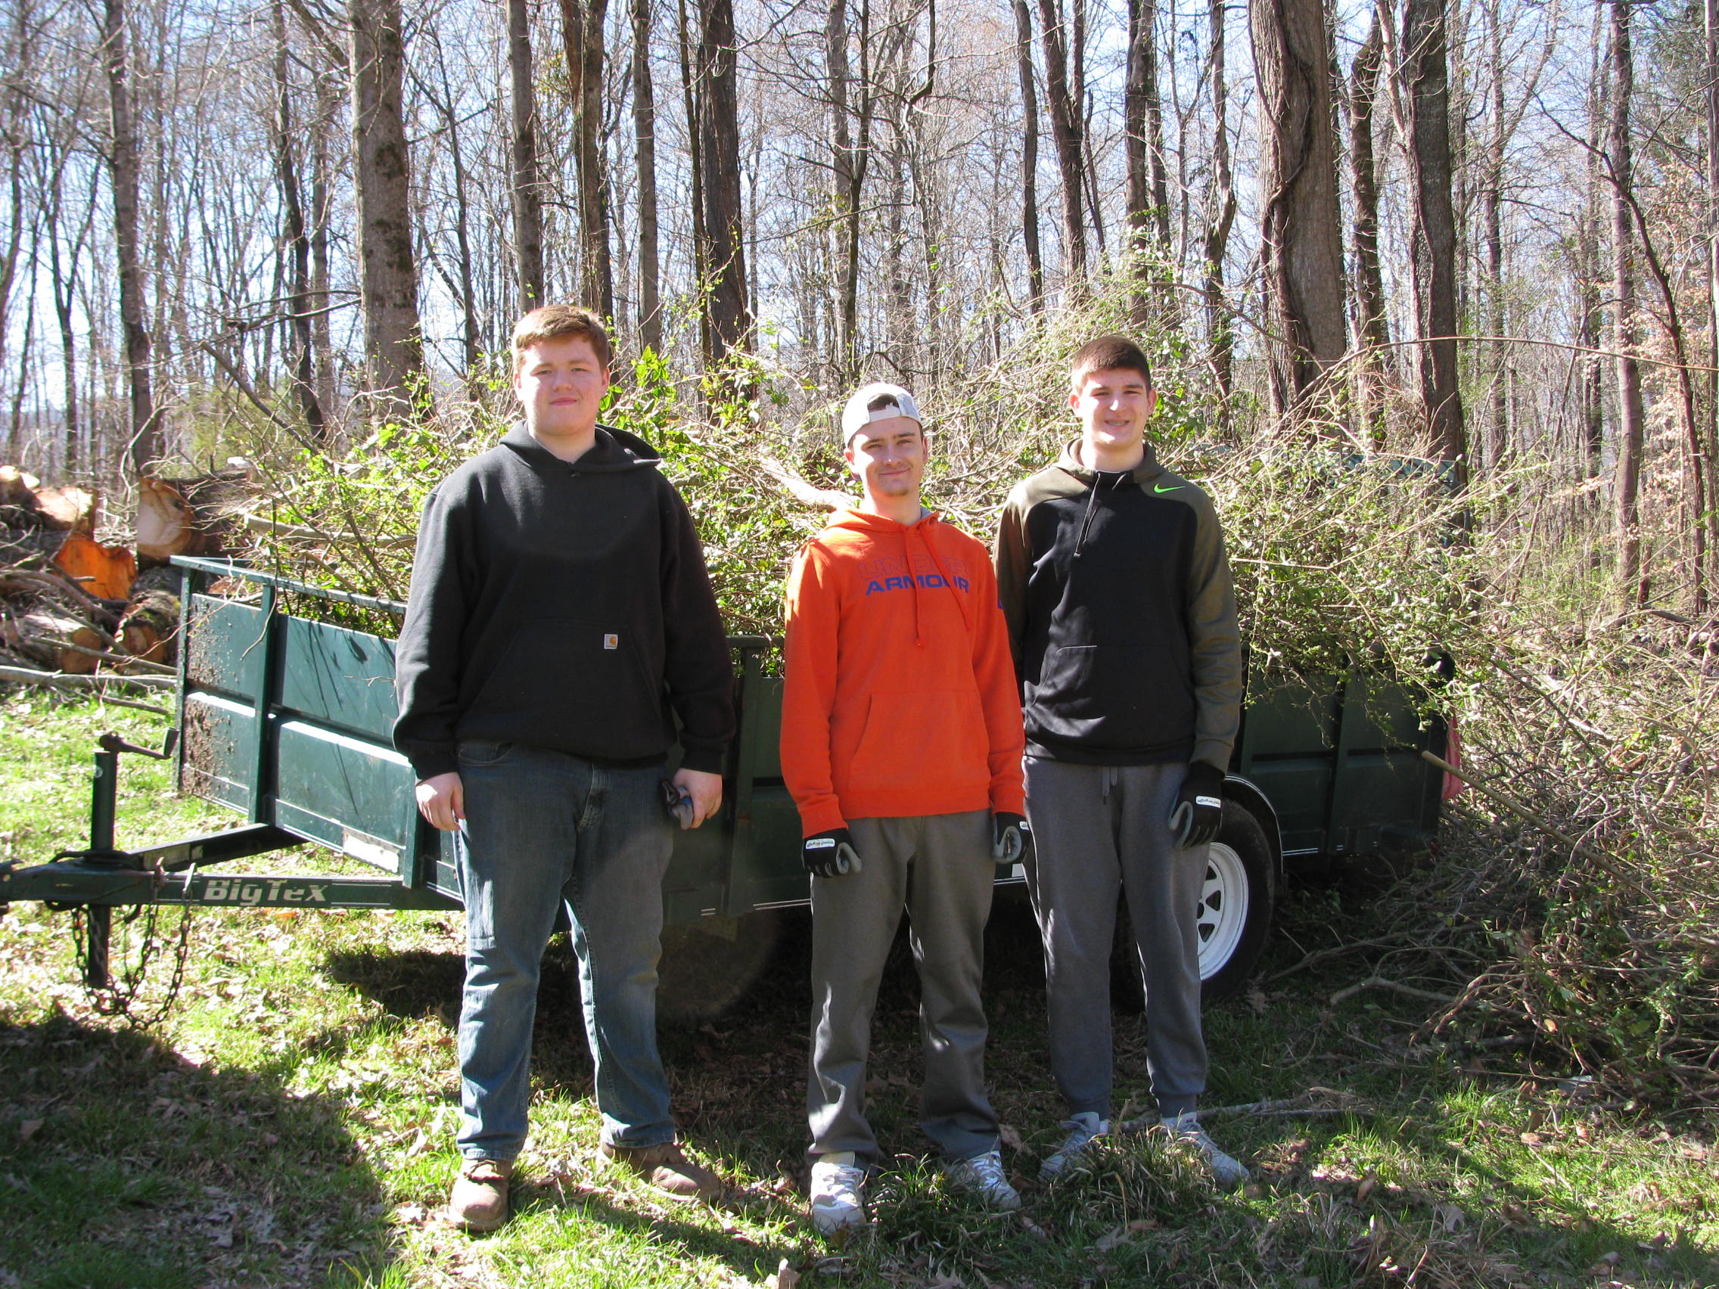
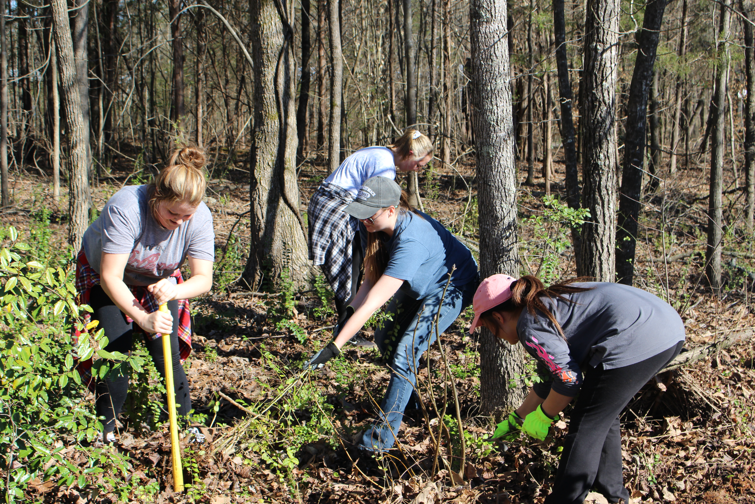
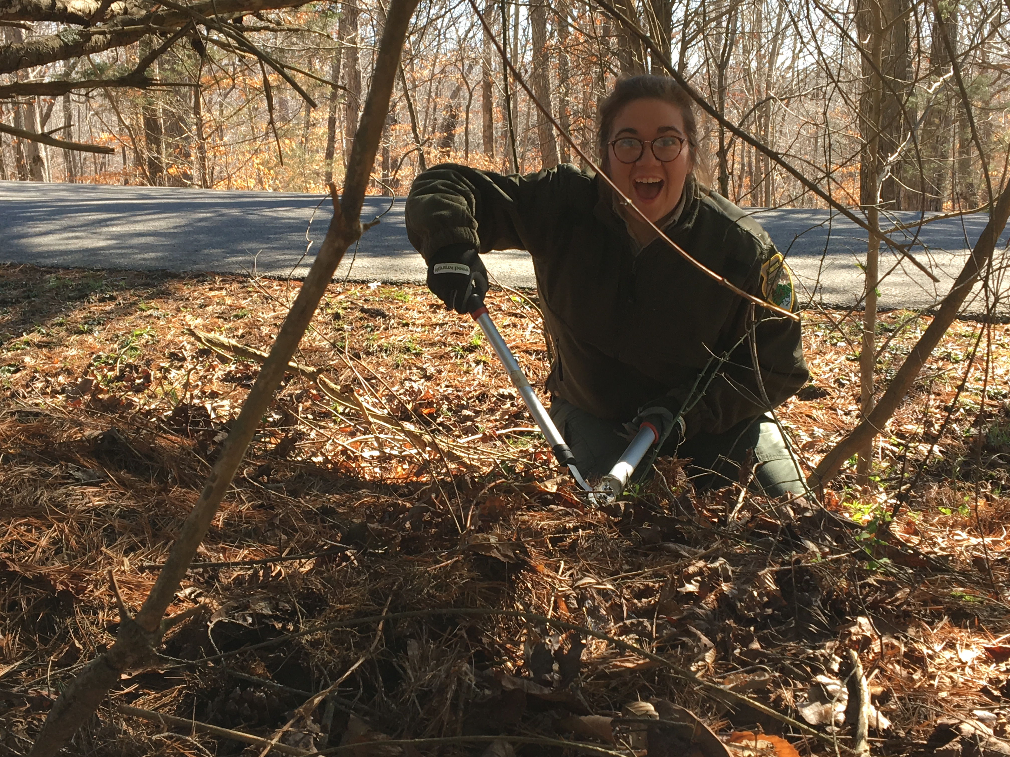
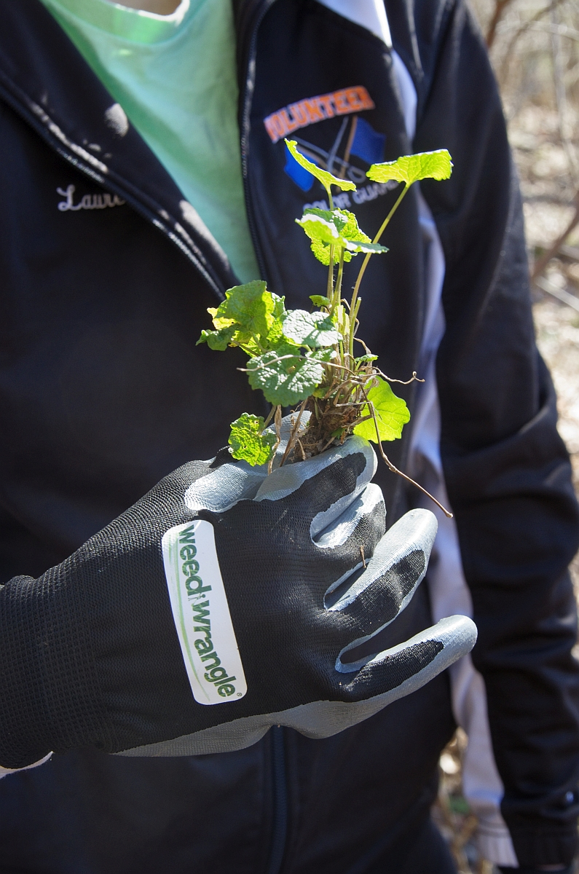
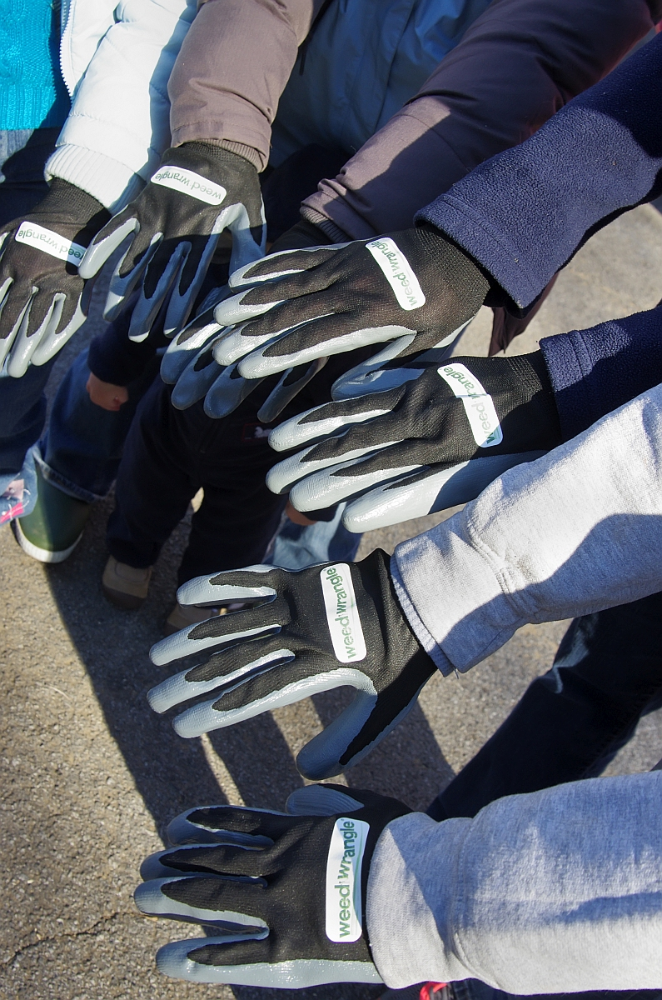
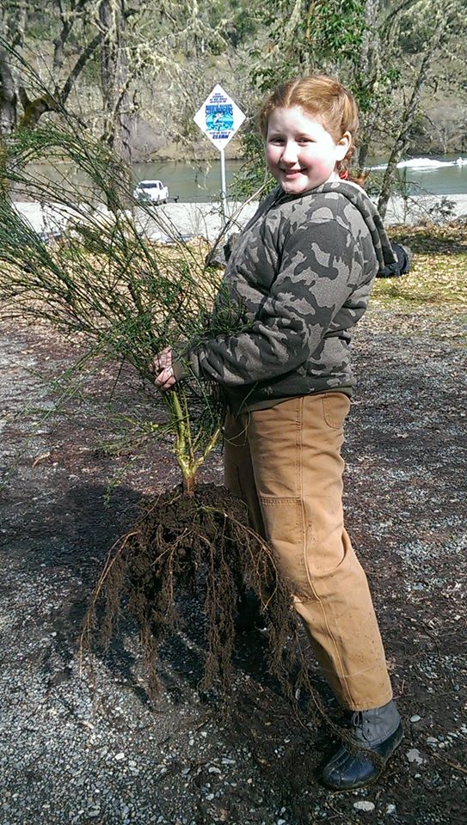
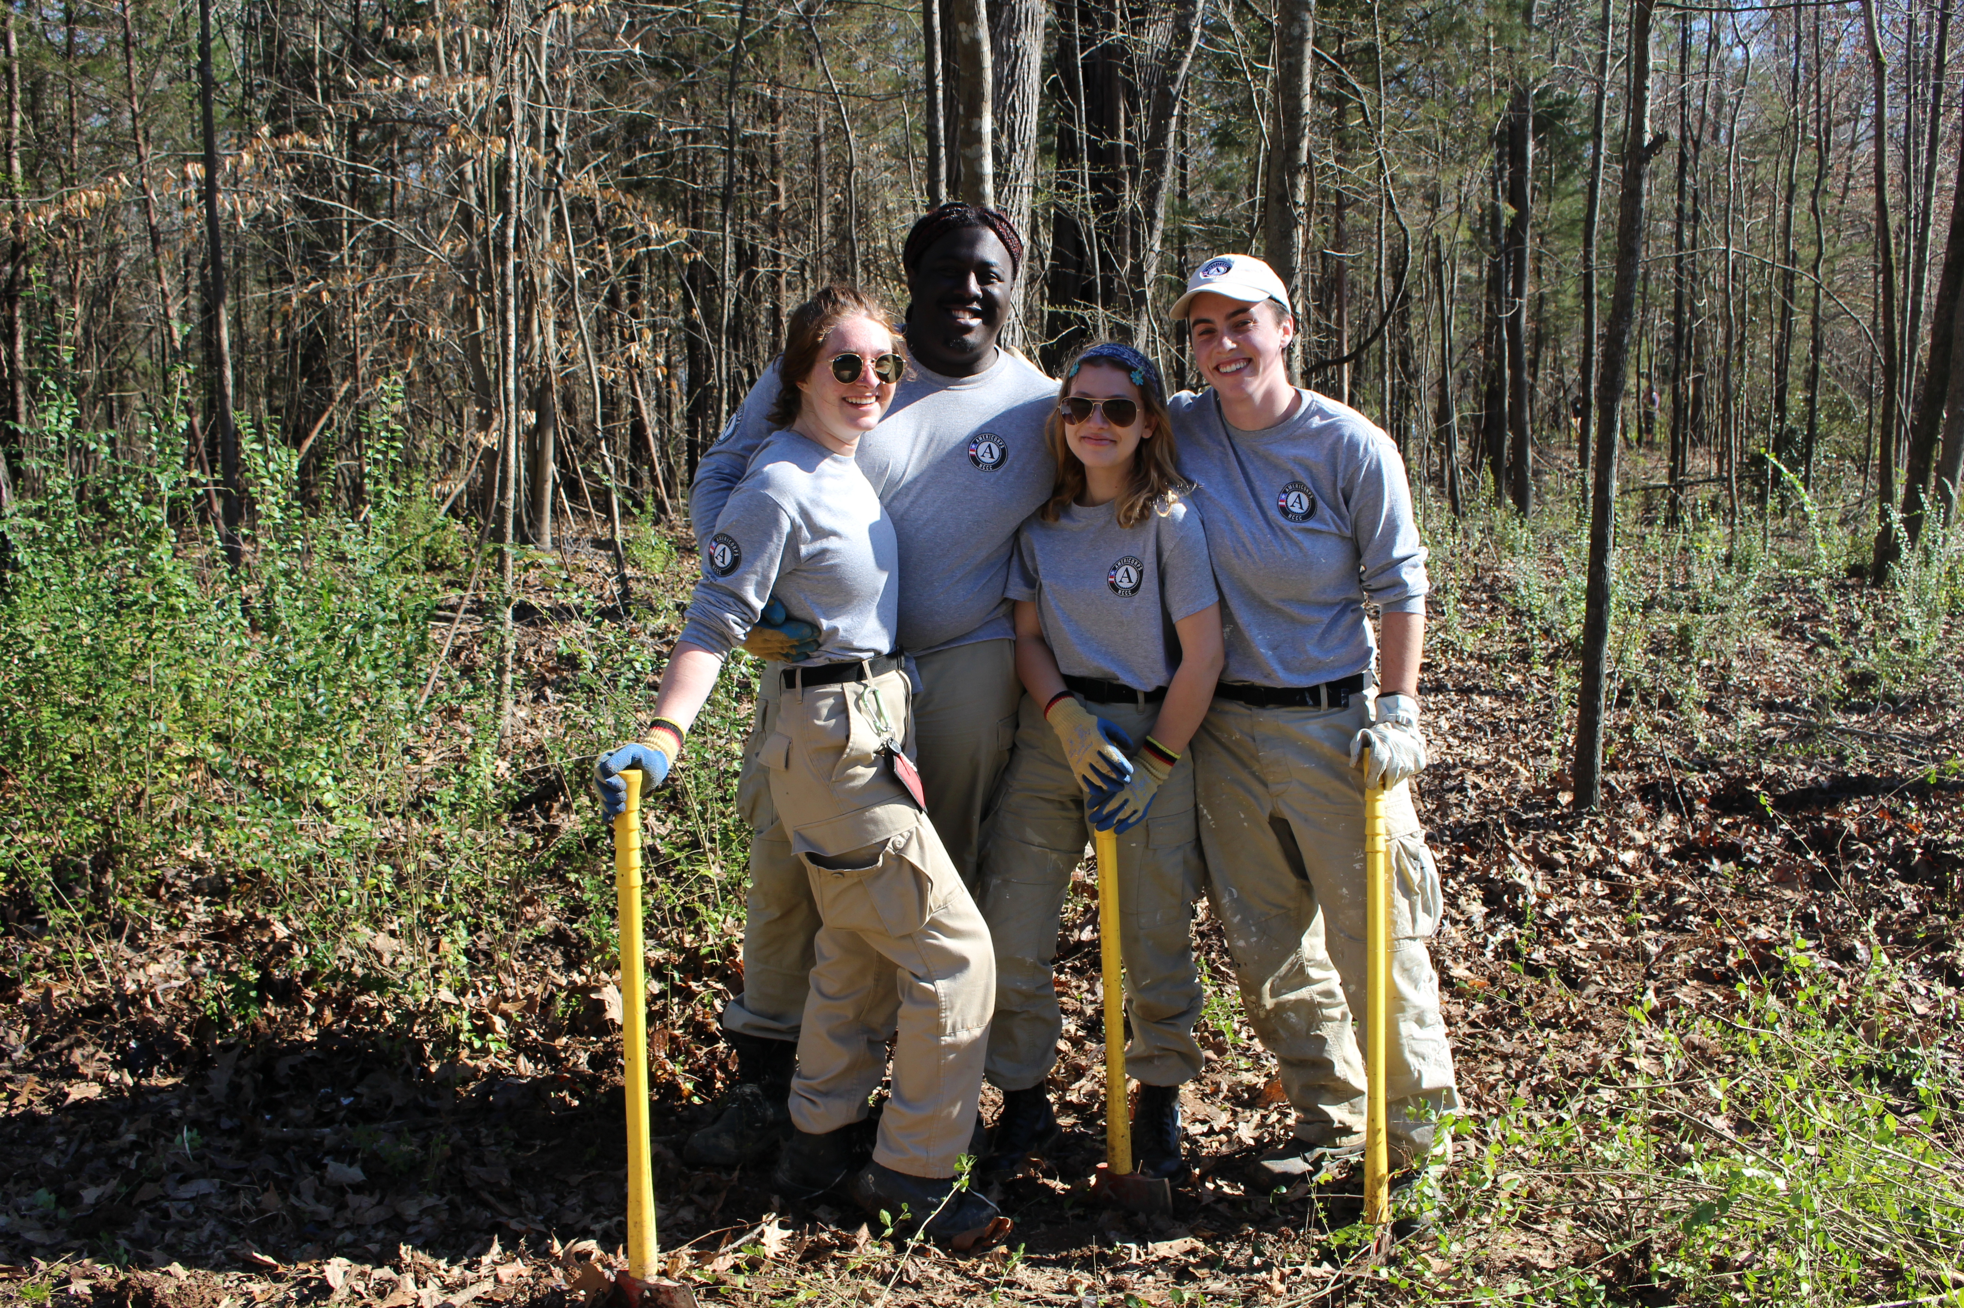

Slide 33
We are happy to send you,
more than you want to know!

Slide 34
North Carolina
French Broad River Garden Club, Ashville
Twin City Garden Club, Winston-Salem
South Carolina
Garden Club of Aiken, Aiken
Carolina Foothills Garden Club, Greenville
Palmetto Garden Club, Columbia
We Are
Missing Two
Southern States!

Slide 35
For more information, visit www.weedwrangle.org
To host your own Weed Wrangle®
Email invasives@icloud.com
Call (615) 385-4319
Notes:
As Weed Wrangle® continues to grow, The Garden Club of Nashville has created a template and PR toolkit that can be easily used by all GCA clubs and other organizations across the country, to plan and execute their own Weed Wrangle® project.
If you would like to implement a Weed Wrangle visit website or contact Steve Manning

